Slide 1
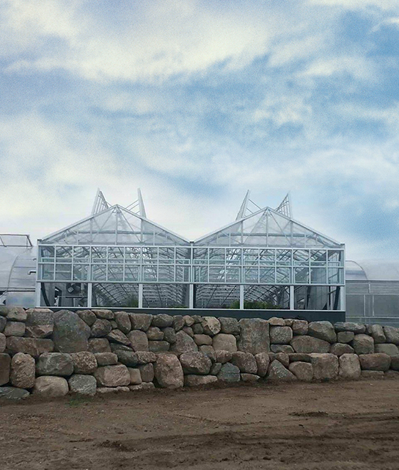

Cast 2025
Review & New Variety HIGHLIGHTS

Slide 2
Seed Varieties
Annuals

Slide 3

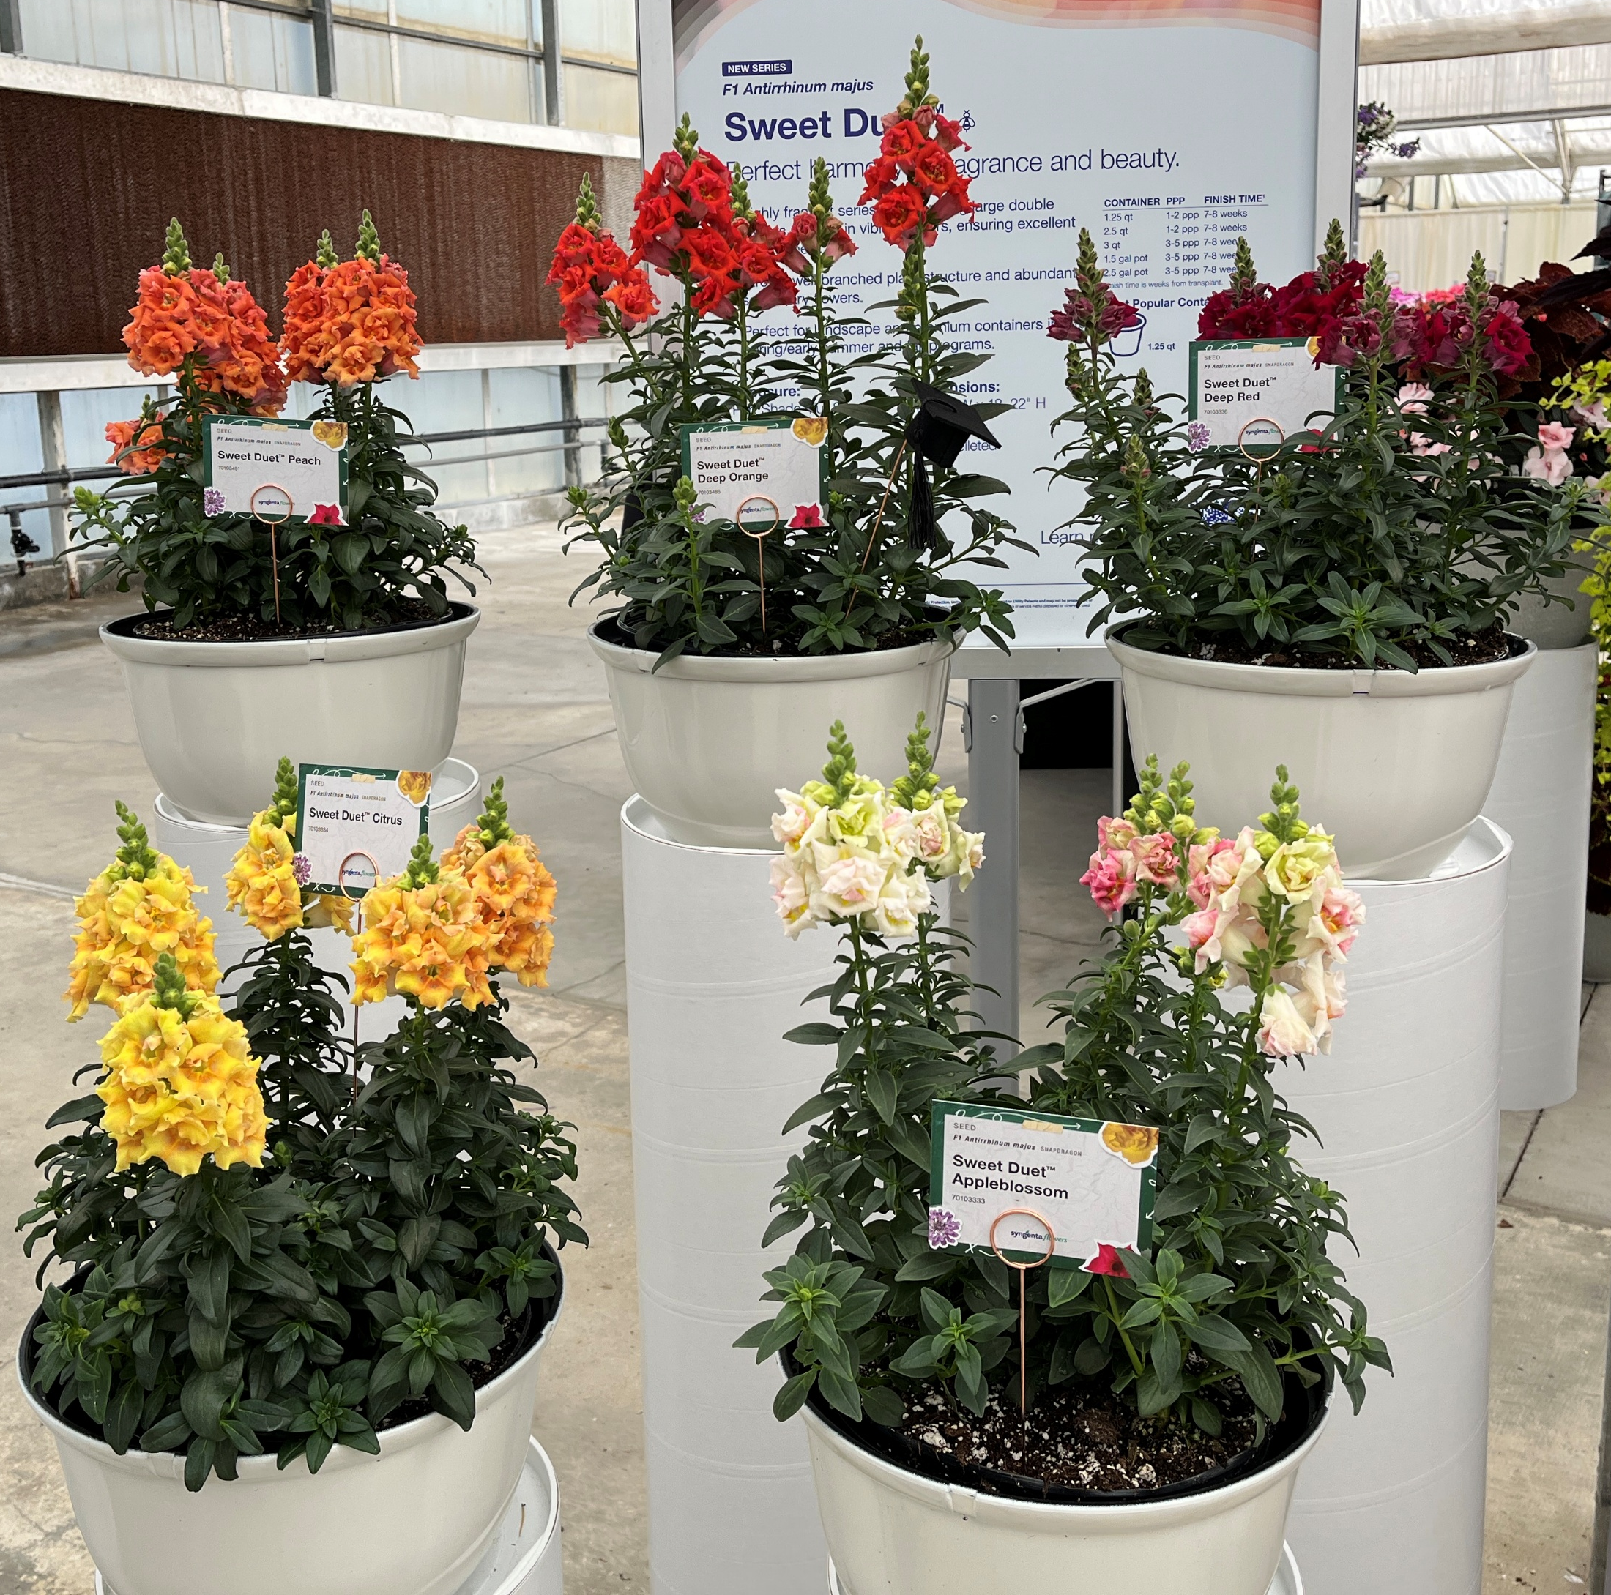
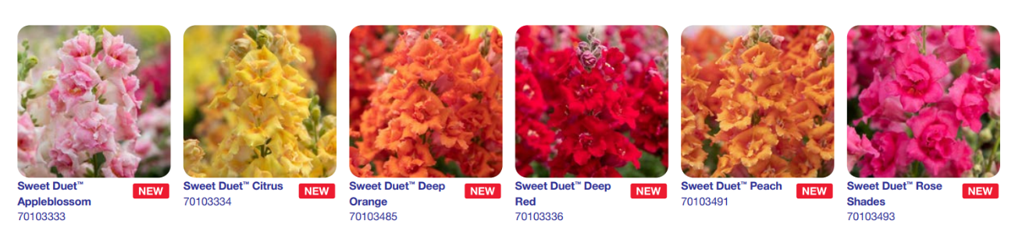
Antirrhinum Majus F1 Sweet Duet ™
Experience the perfect blend of fragrance and beauty.
• This highly fragrant series features stunning, large double flowers in vibrant colors, ensuring strong retail appeal.
• Boasting a robust, well-branched structure with abundant secondary blooms.
• Ideal for landscapes and premium containers in late spring, early summer, and fall programs
Flowers 1.5 weeks faster when finished under warmer temperatures 76F vs cool 62.5F
Part Shade-Full Sun
Flowering- Late Spring-Fall
Upright Habit
Garden Dimensions- 10-14”W x 18”22”H
2.5 qt to 1.5 gal container

Slide 4
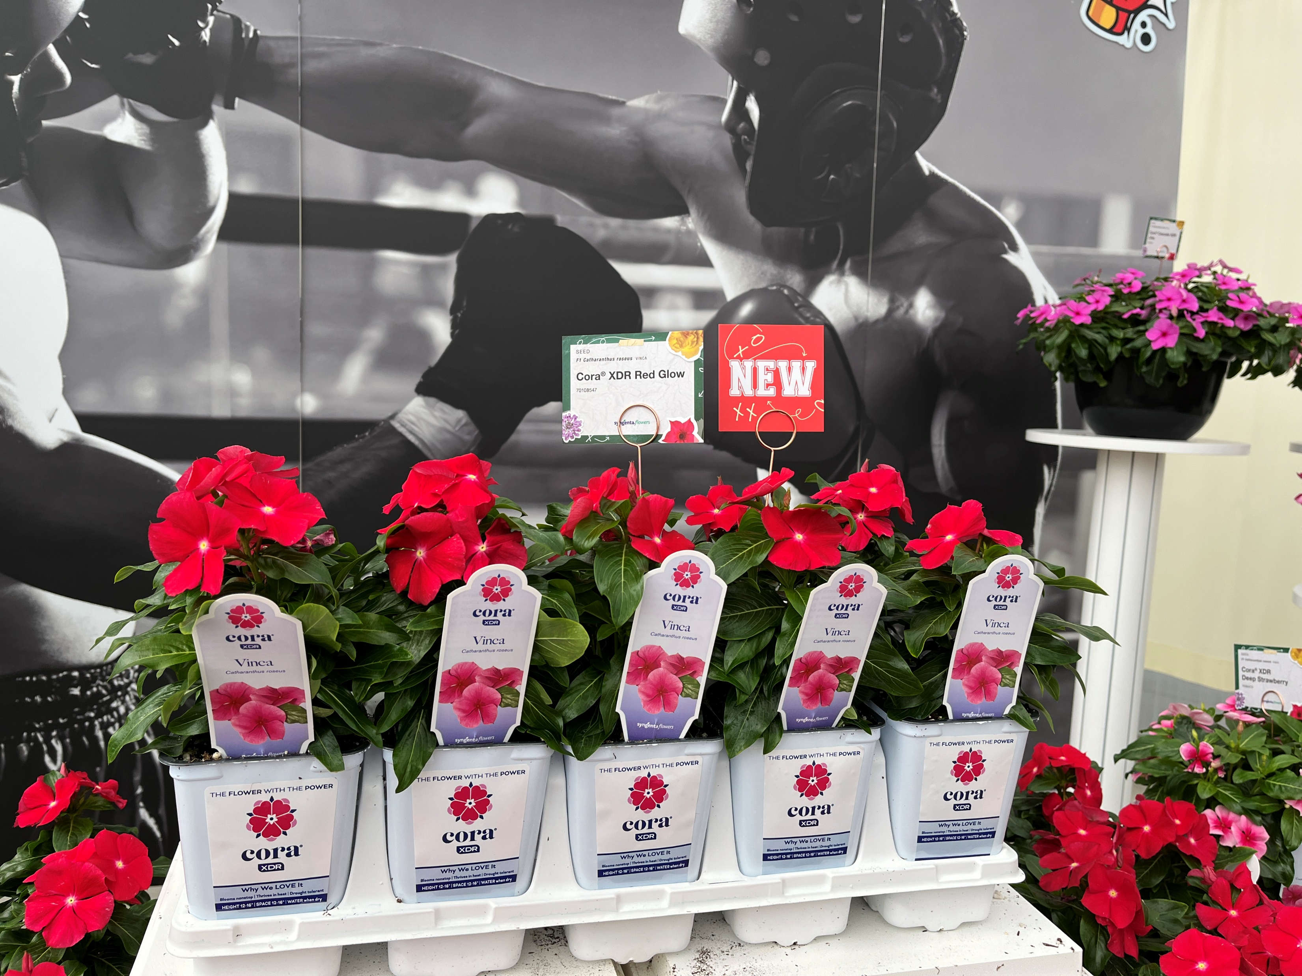
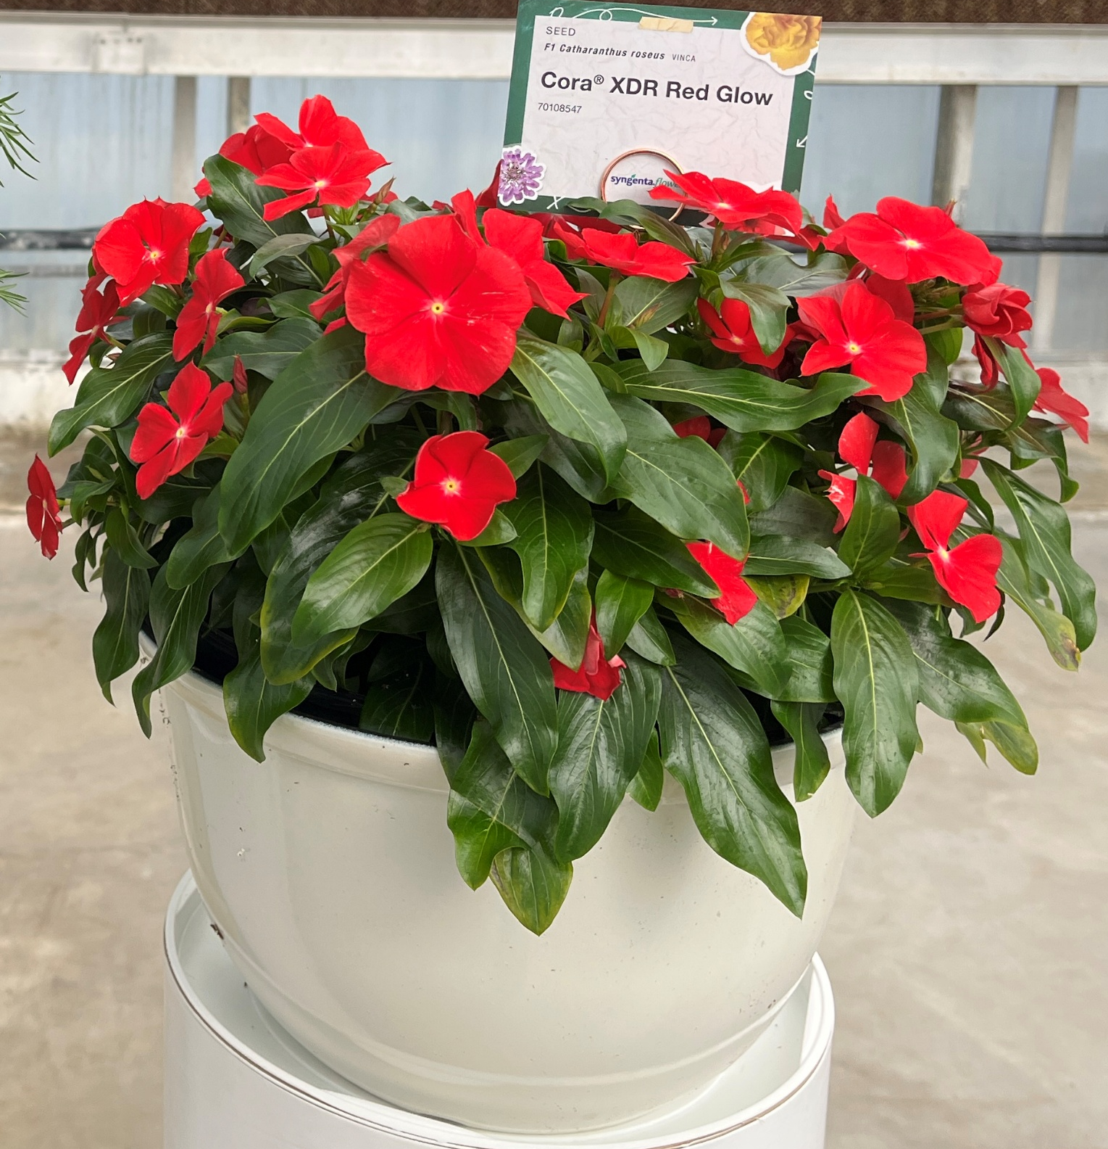
Vinca Cora® XDR Red Glow
The Flower with the Power!
Reduced Risk: Unmatched disease resistance ensures season-long blooms for landscape plantings. Rigorously tested against 35 contemporary strains of Aerial Phytophthora, including the 10 most aggressive strains known to cause Phytophthora blight on annual vinca.¹
Easy to Grow: Superior branching, uniformity, and vibrant flowers make Cora XDR the top choice for everything from premium packs and small pots to large containers.
Higher Consumer Appeal: Stunning, oversized blooms available in the widest selection of solid and bicolor patterns among all disease-resistant vincas on the market.
Full Sun
Mid Spring- Summer
Upright Habit
Garden Dimensions- 12-18” W x 12-16”H
Packs, Pots and the Landscape

Slide 5
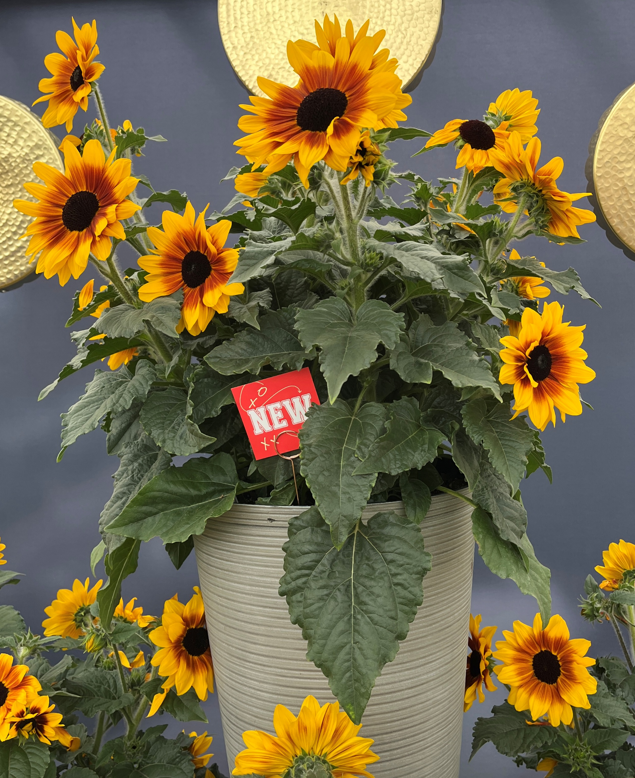
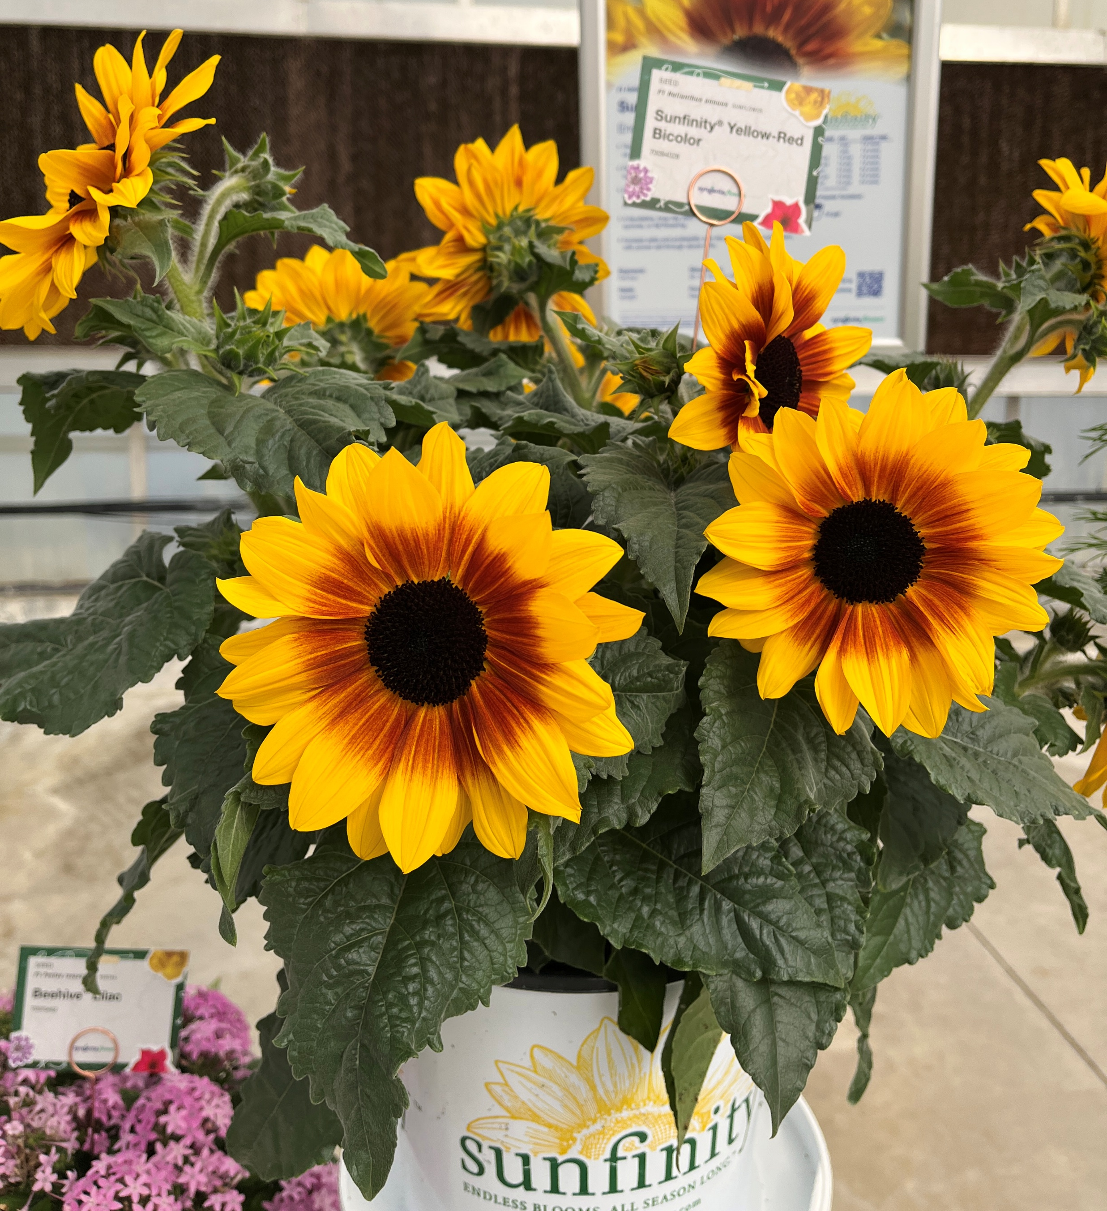
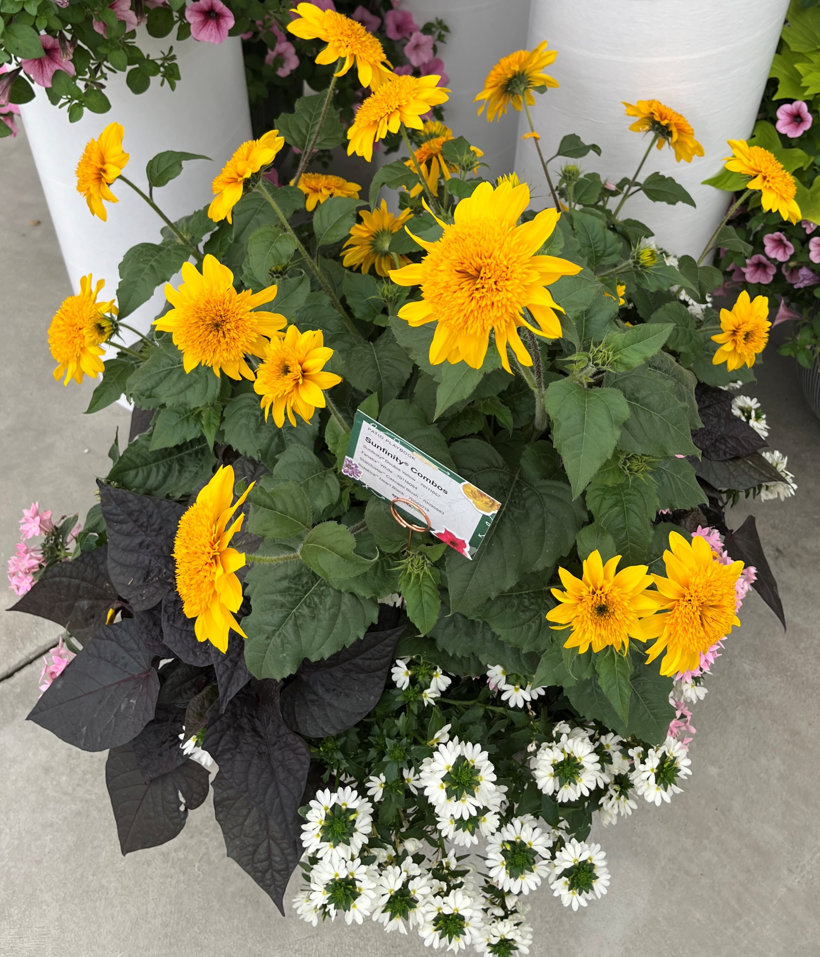
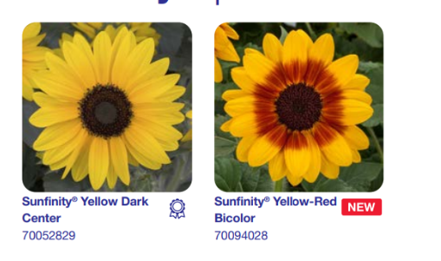
Sunfinity® Yellow-Red Bicolor
Endless Blooms, All Season Long.™
• This next-generation sunflower delivers continuous blooms for up to 12 weeks of vibrant garden color.
• Offers a longer shelf life than traditional pot sunflowers, which lose value after their first bloom.
• As a facultative long-day plant, it’s easy to program for spring, summer, or fall flowering.
•Raker has seed and will produce in a 36 strip to ship this late spring/summer
Full Fun
Late Spring- Summer, into Fall
Upright Habit
Garden Dimensions 24-32”W x 48”H
Great for large containers and the Landscape

Slide 6

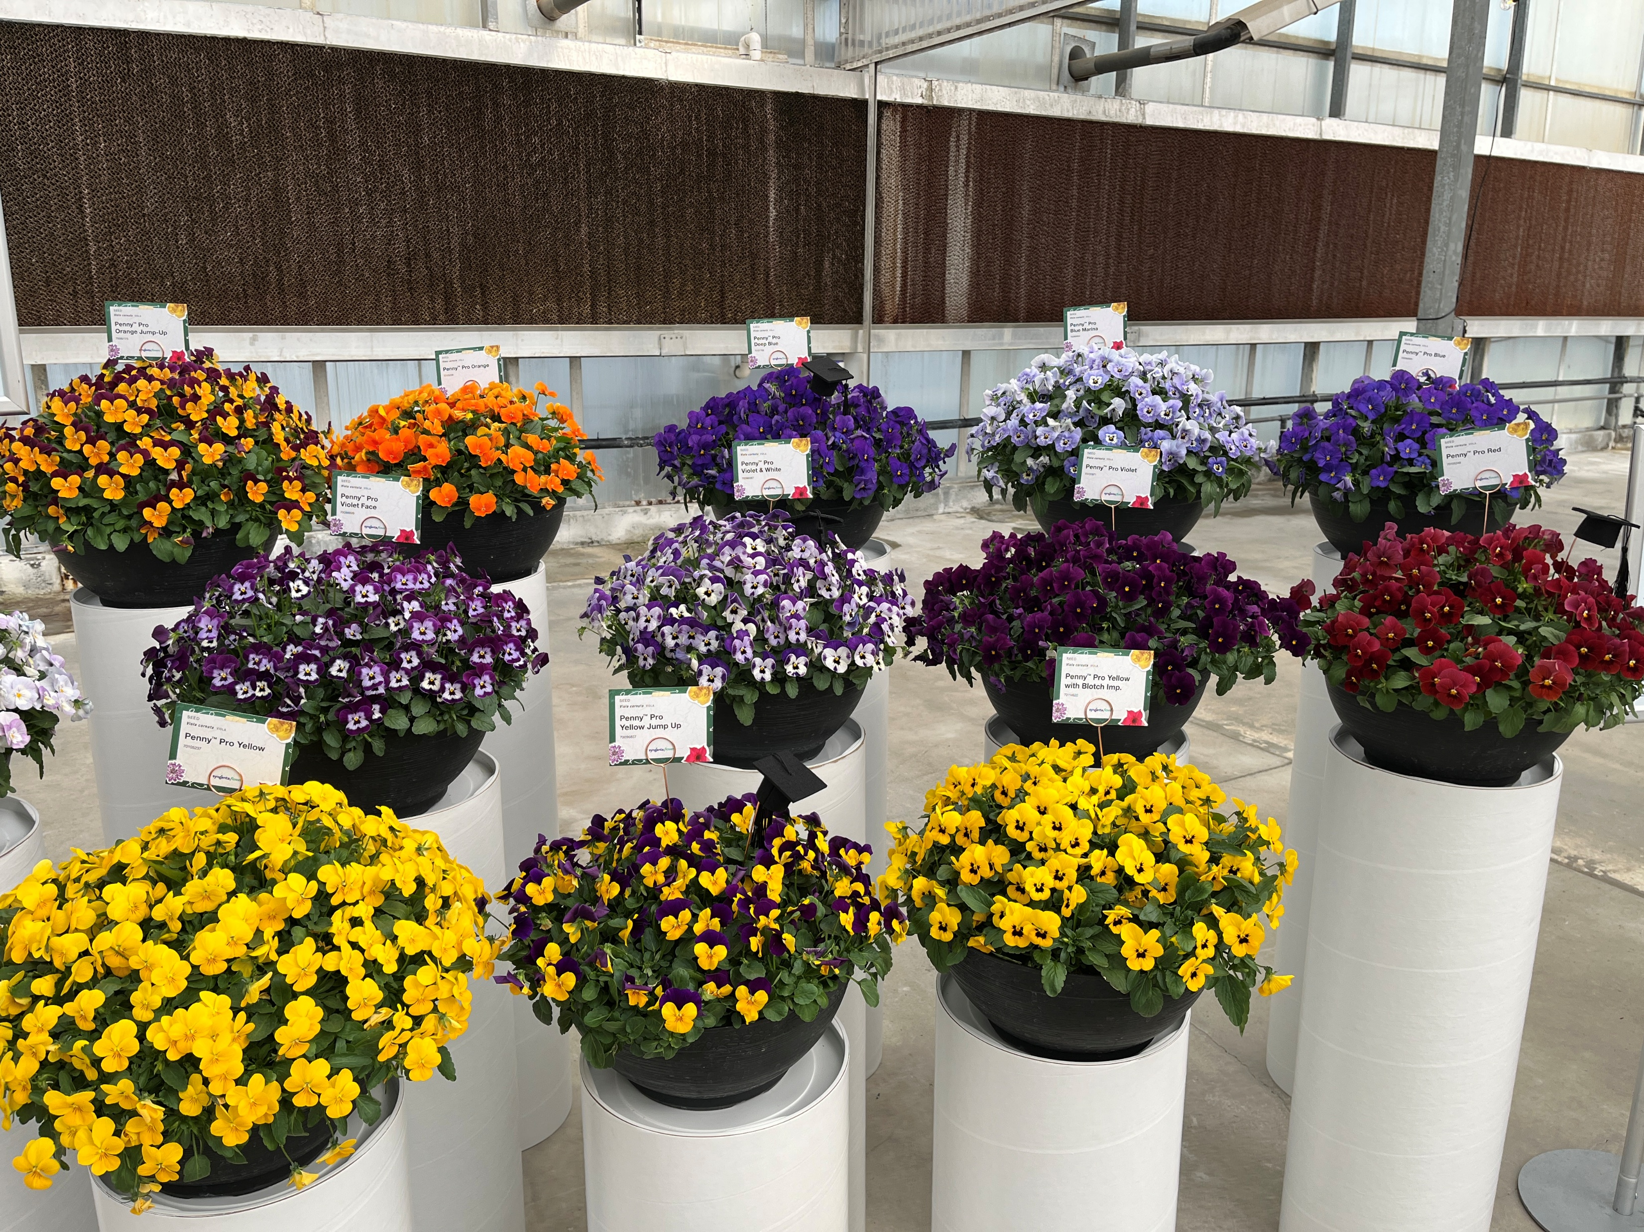
Viola Penny® Pro
Produced for performance - offers efficient solutions for growers from germination to finish.
High level of uniformity across entire series
Designed to perform in both spring and fall
13 colors, mounding habit
  Blue, Blue Marina, Deep Blue, Orange, Orange Jump Up, Pink with Face, Red, Violet, Violet & White, Violet Face, Yellow, Yellow Jump up, Yellow with Blotch
Tightly branched and non stretching habit reduces the need for PGR’s
High programmability and germination make viola production efficient and profitable
Height 4 – 6”
Best for packs, large packs, pints, quarts

Slide 7

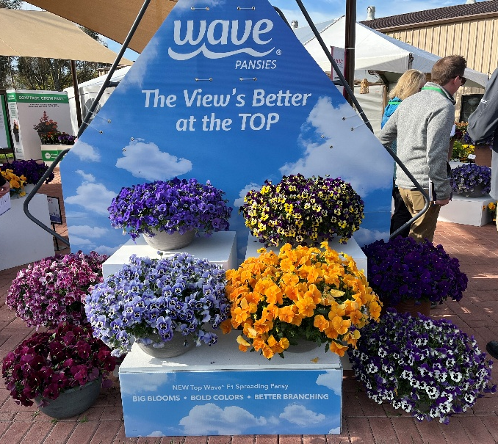
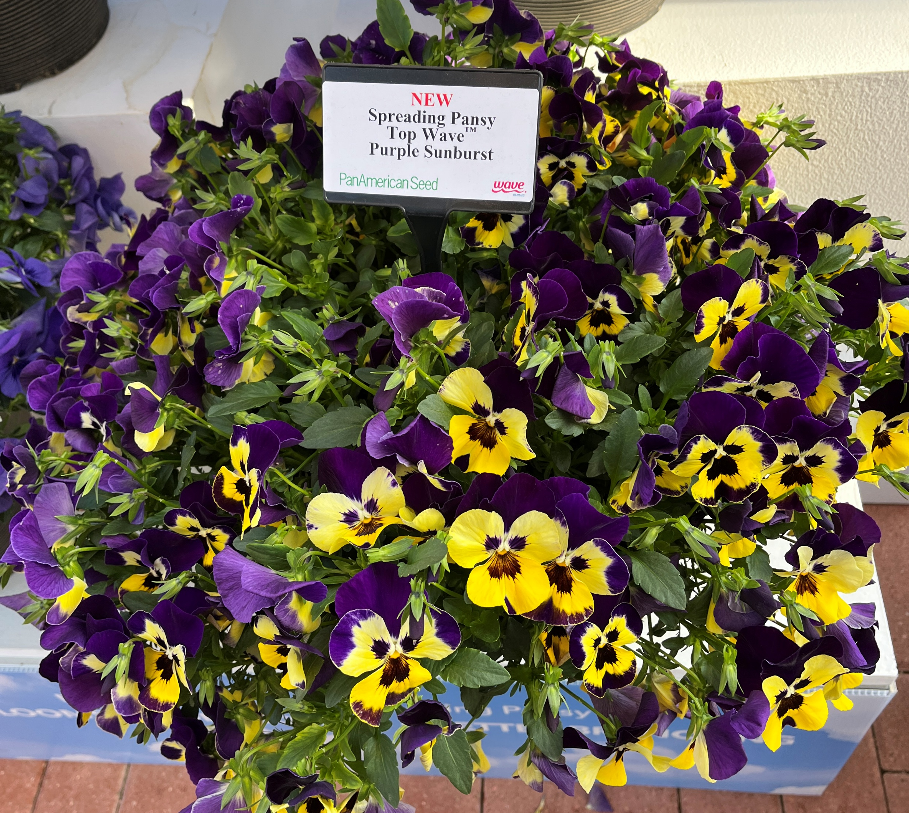
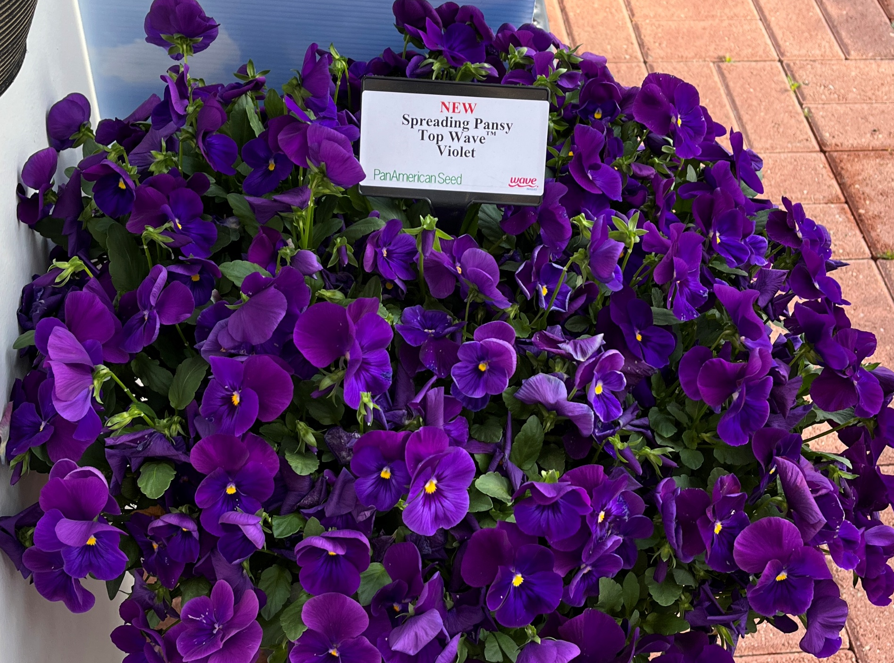
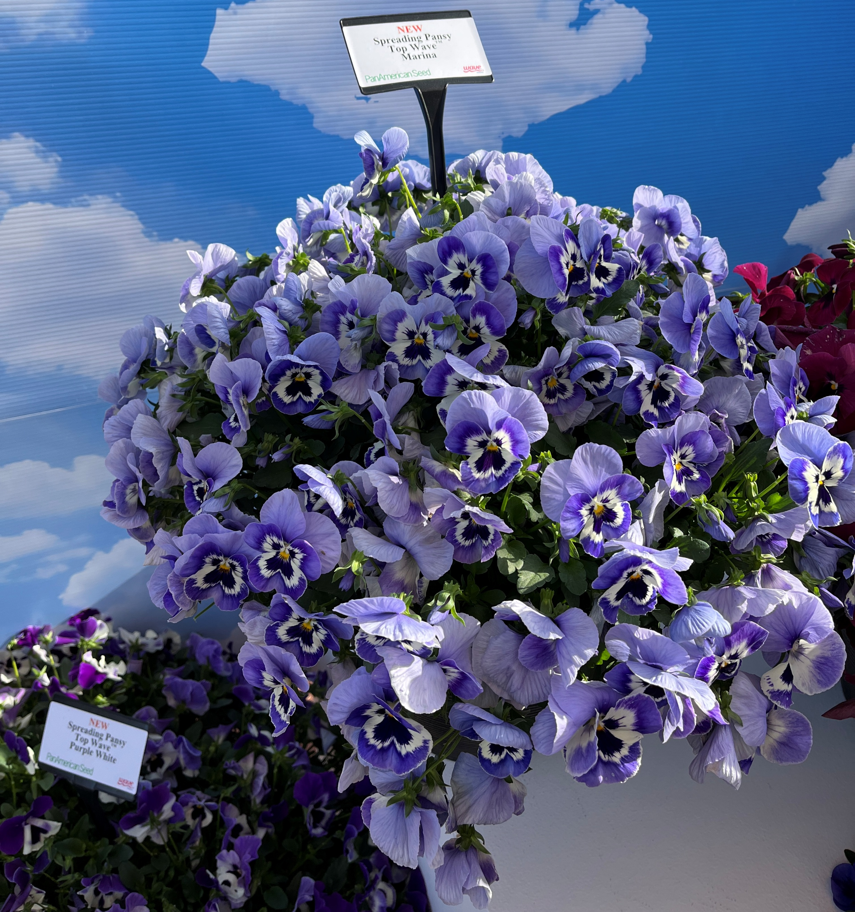
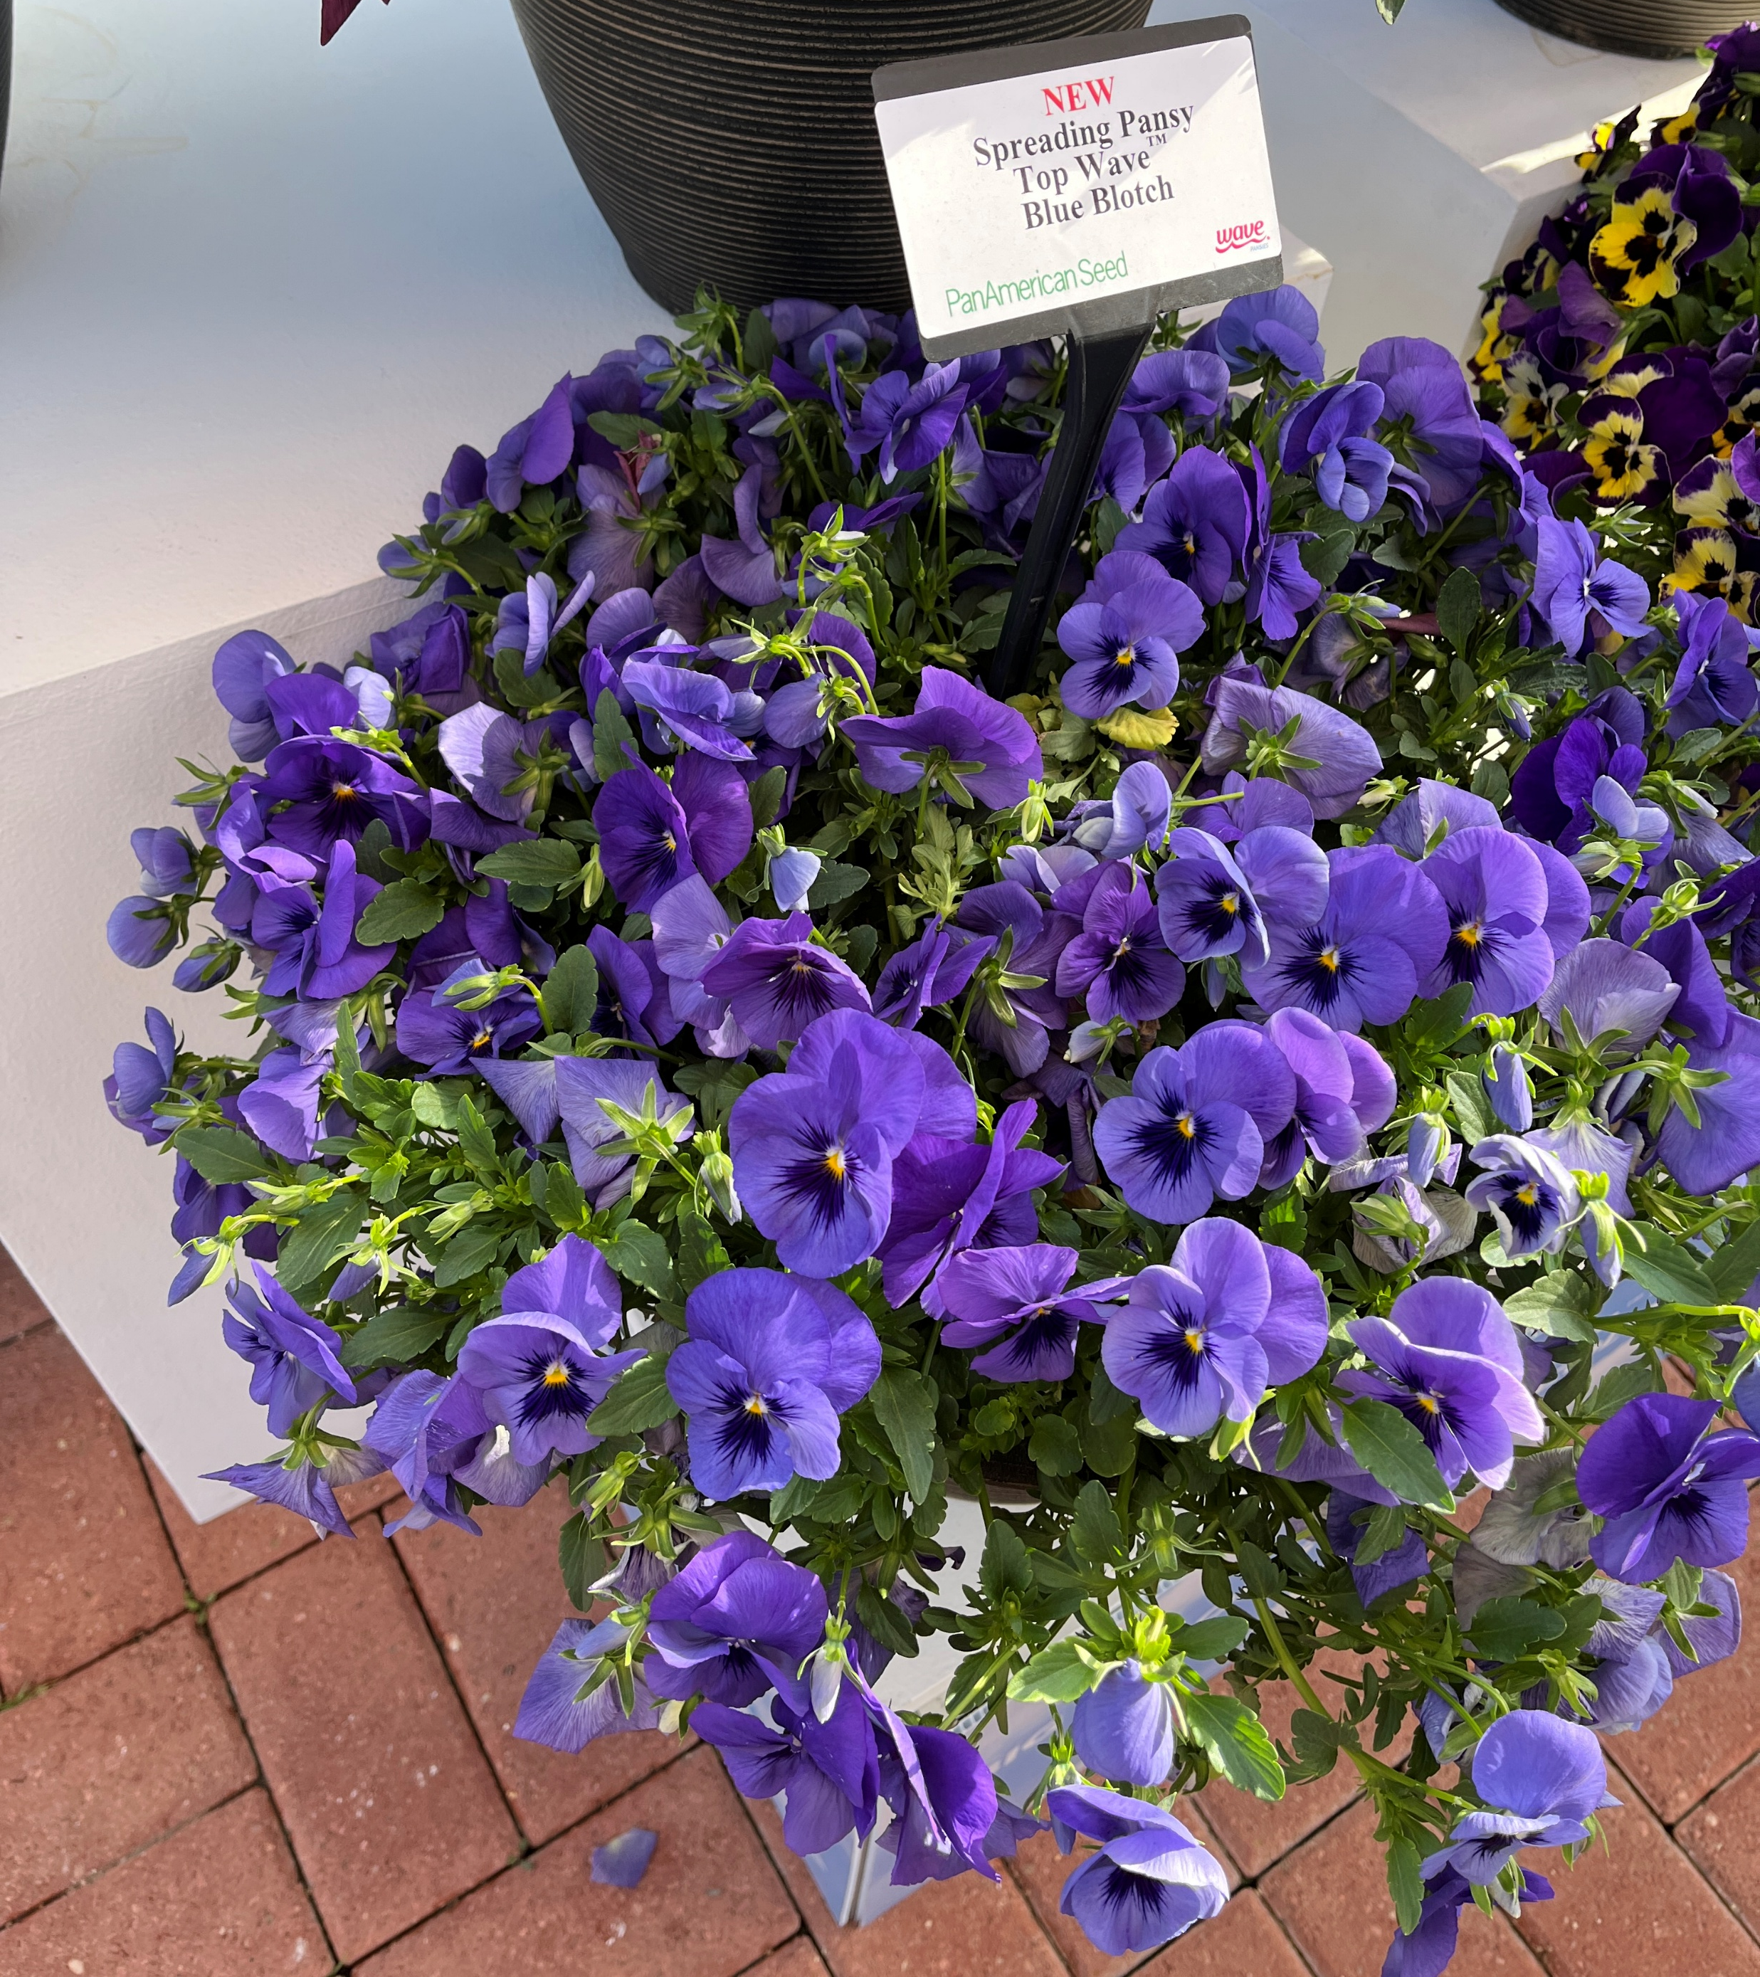
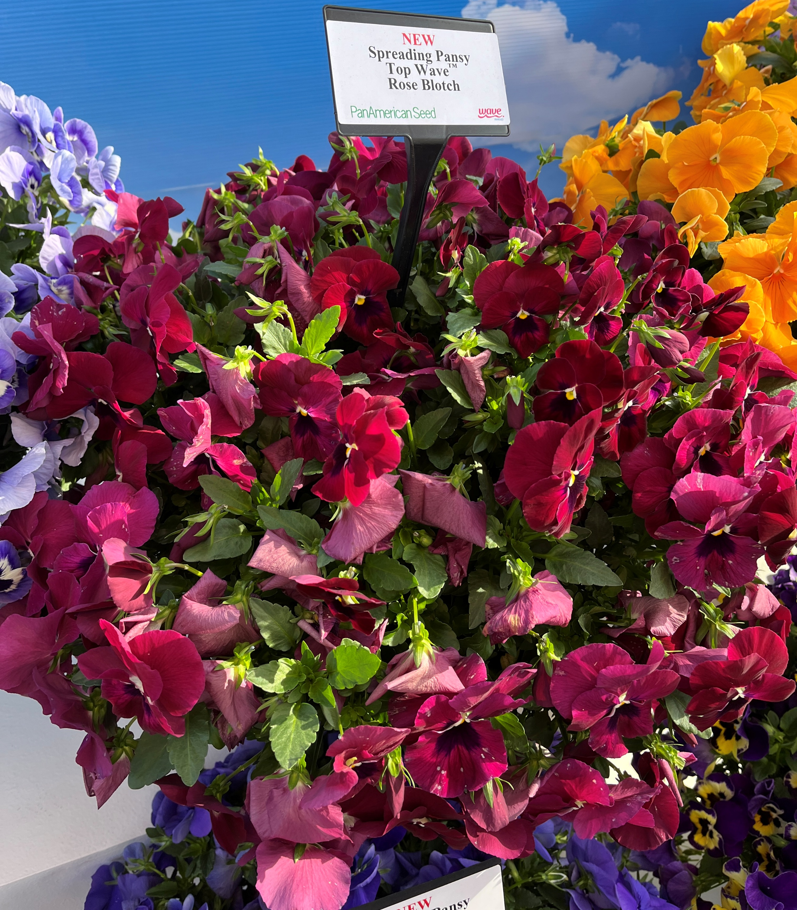
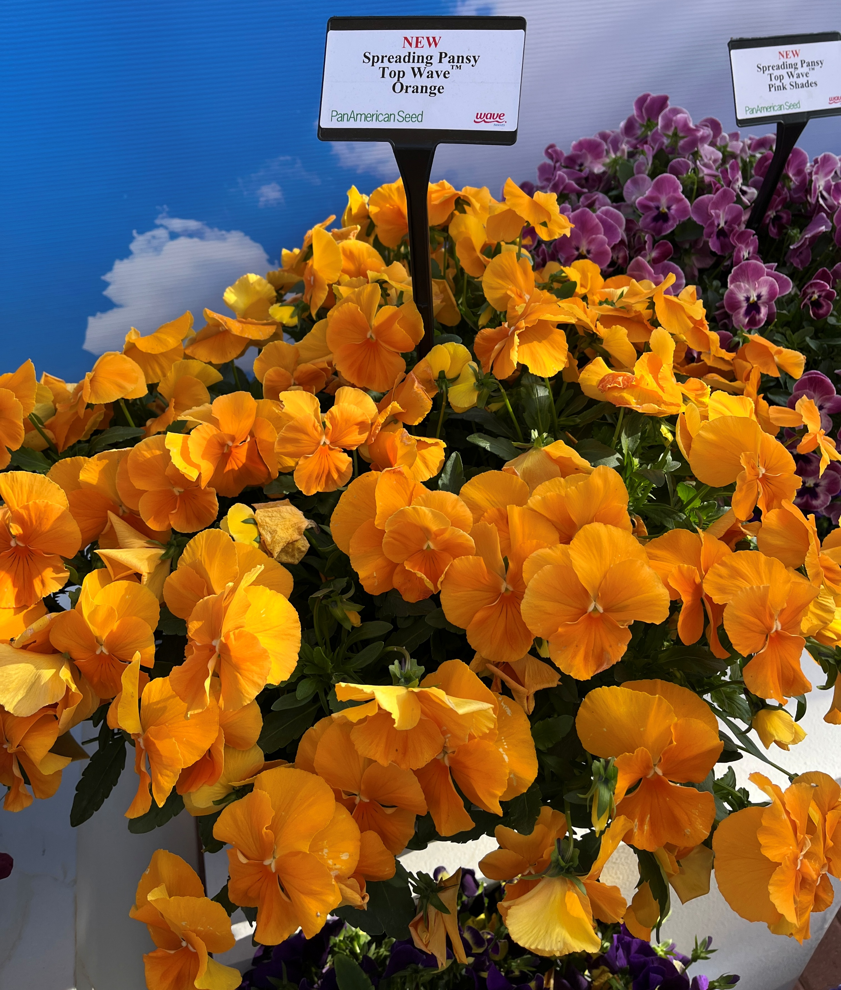
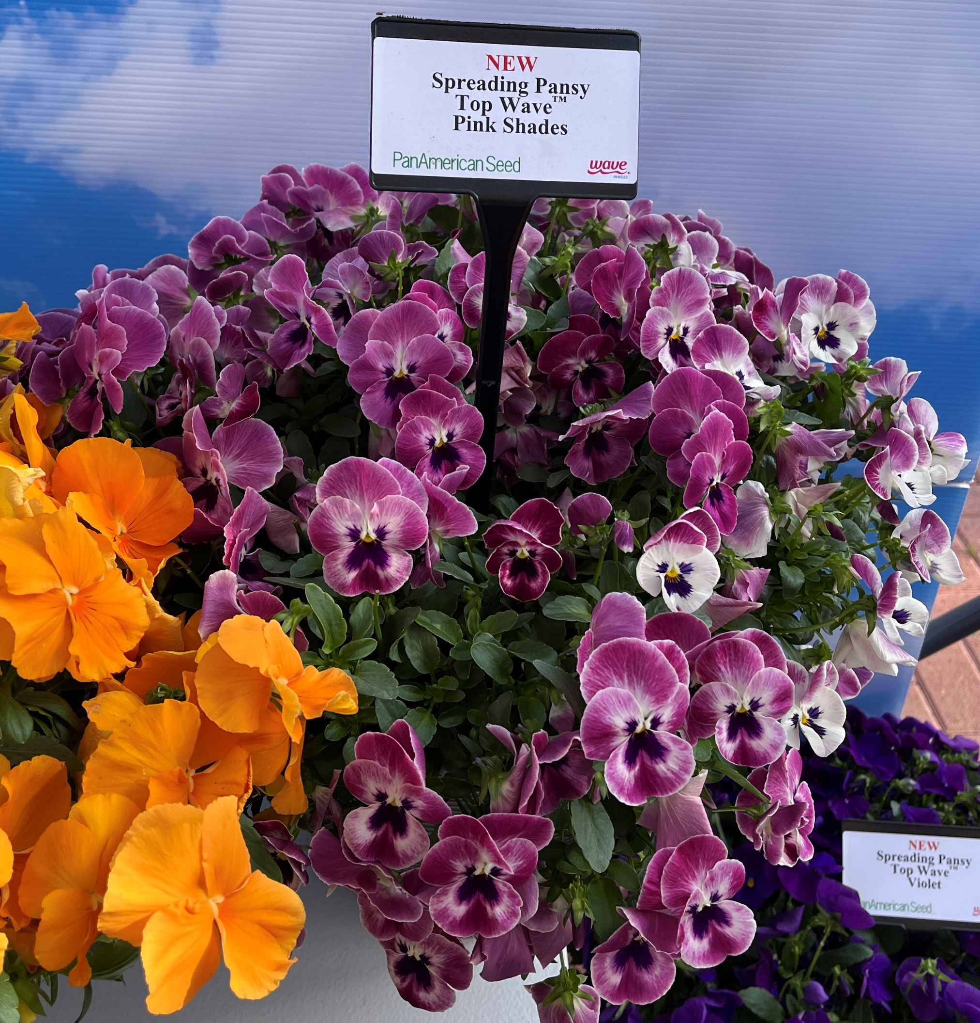
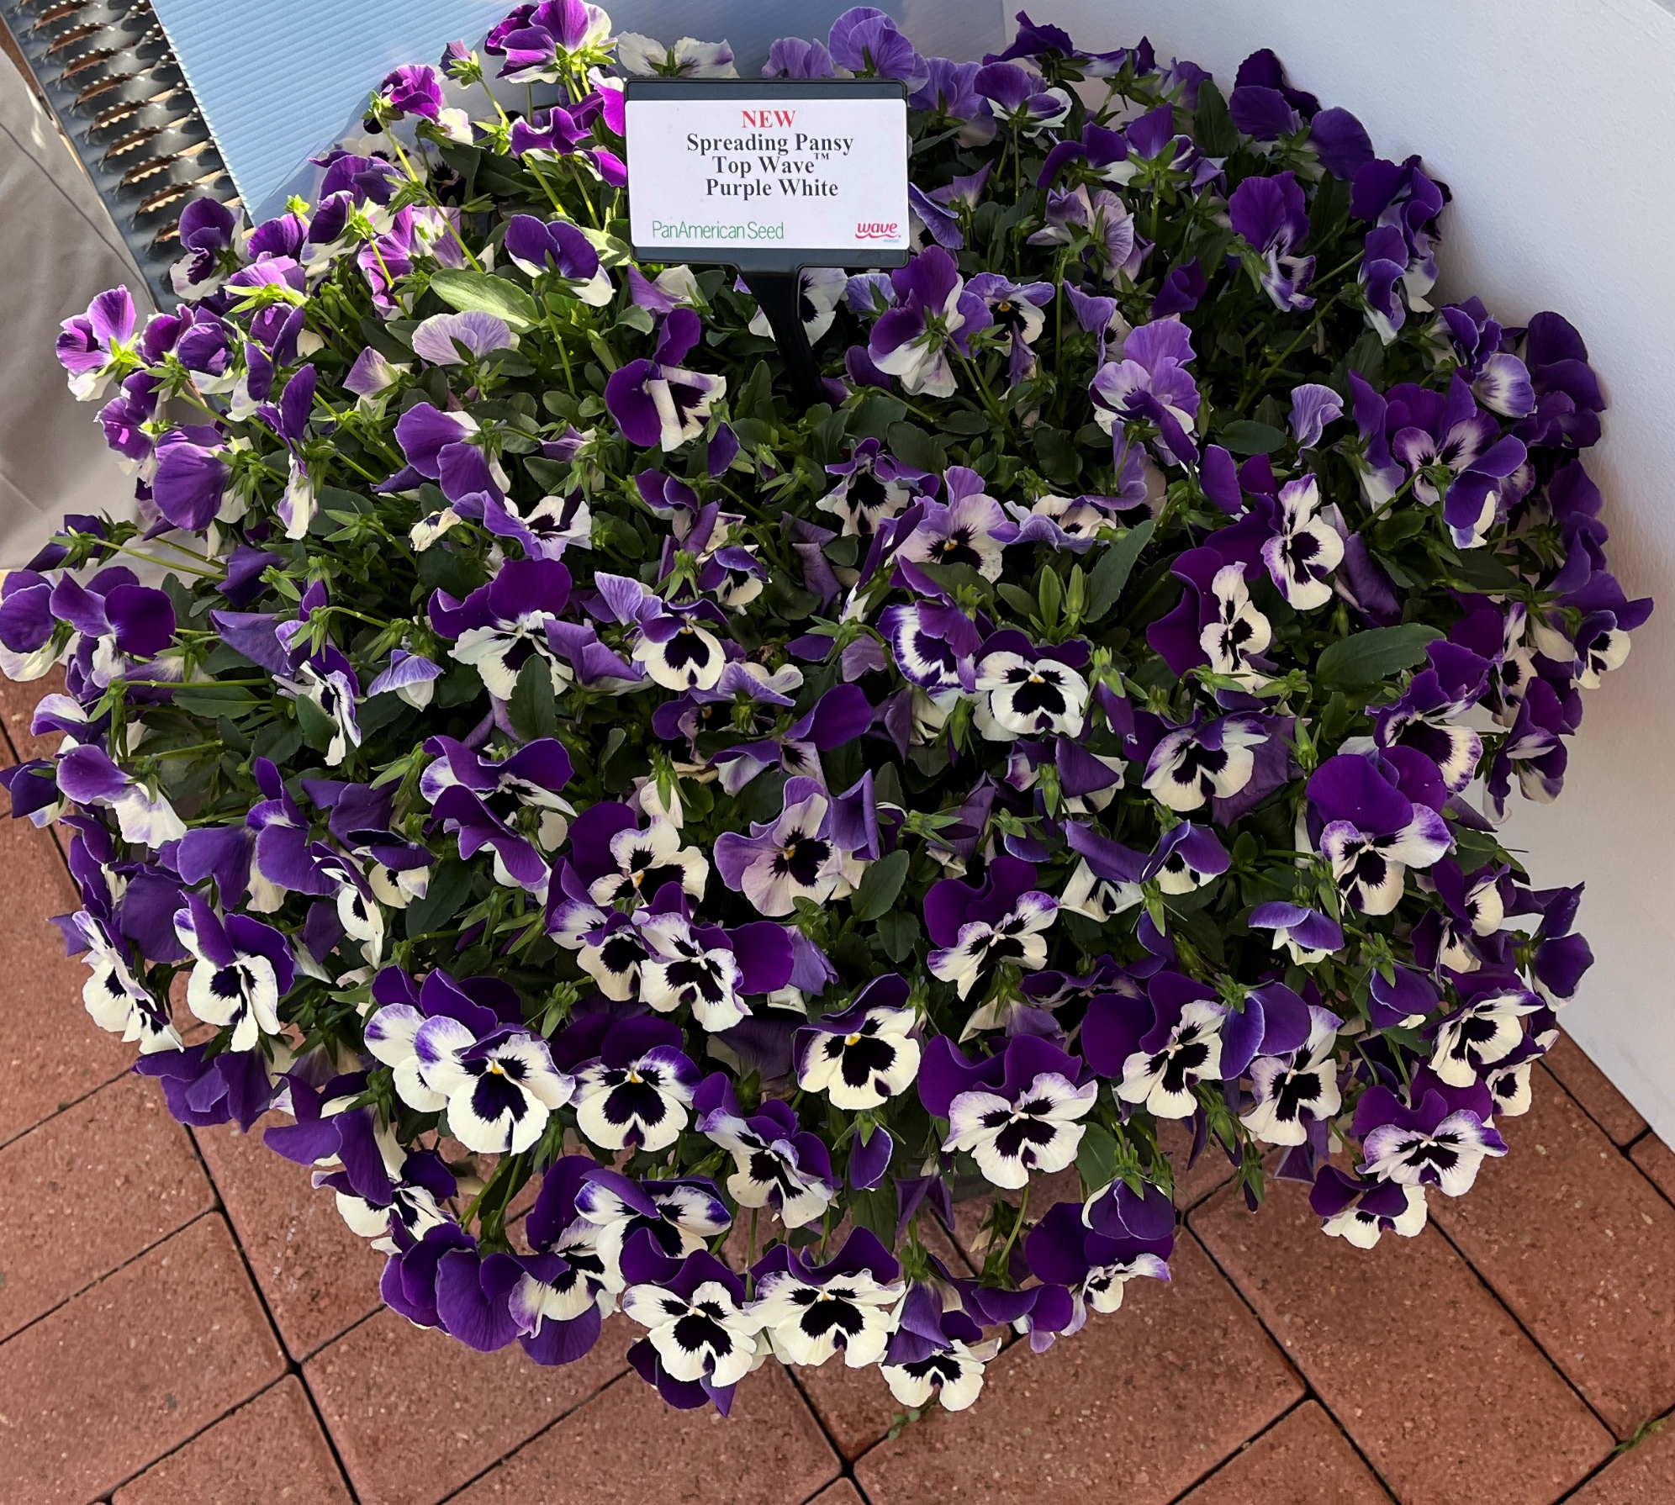
Pansy Top Wave™ -New Series
Offers different colors on a more spreading habit than Cool Wave
25% larger flower than Cool Wave® (more Viola size)
8 new colors including an orange which is the most unique, no color overlap with Cool Wave®.
  Marina, Blue Blotch, Rose Blotch, Orange, Pink Shades, Purple Sunburst, Purple White, Violet
PGR’s similar to Cool Wave®
Height 7 – 9”
Best for 5 – 6” pots as well as window boxes, baskets and containers

Slide 8
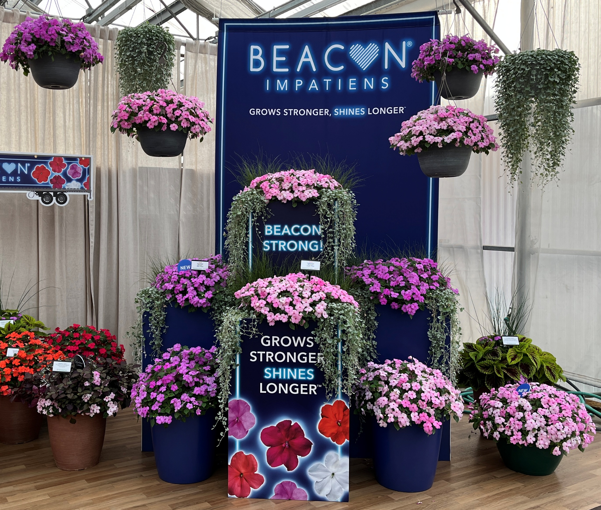
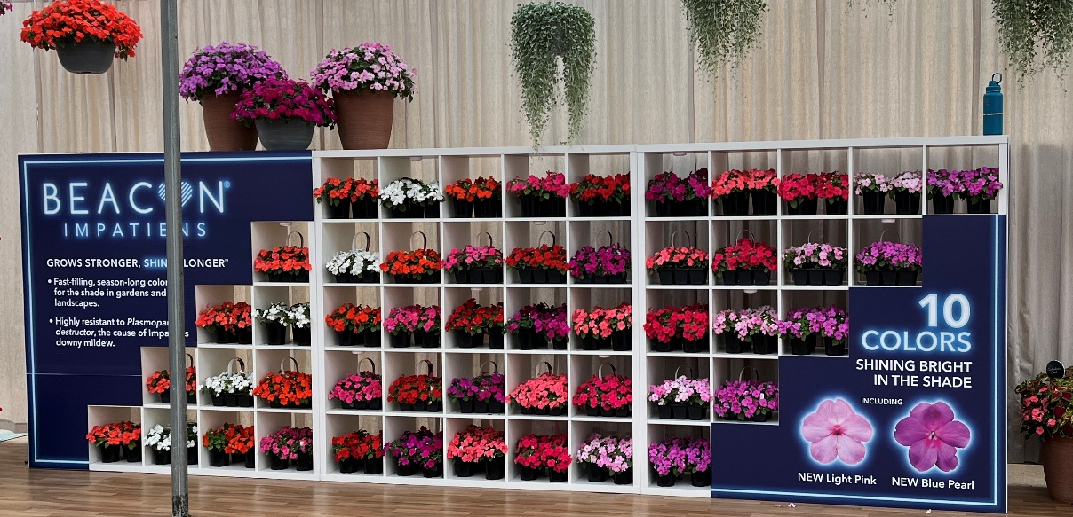
Beacon® Impatiens
Impatiens are back! A reintro for millennials and Gen Z
Beacon® Light Pink = important intro, much needed color
Beacon® Blue Pearl a bit darker than SE Blue Pearl
Future breeding = refinements in vigor & flower size
Seeing growth in sales
Upcoming intros include a solid pink and a bicolor

Slide 9
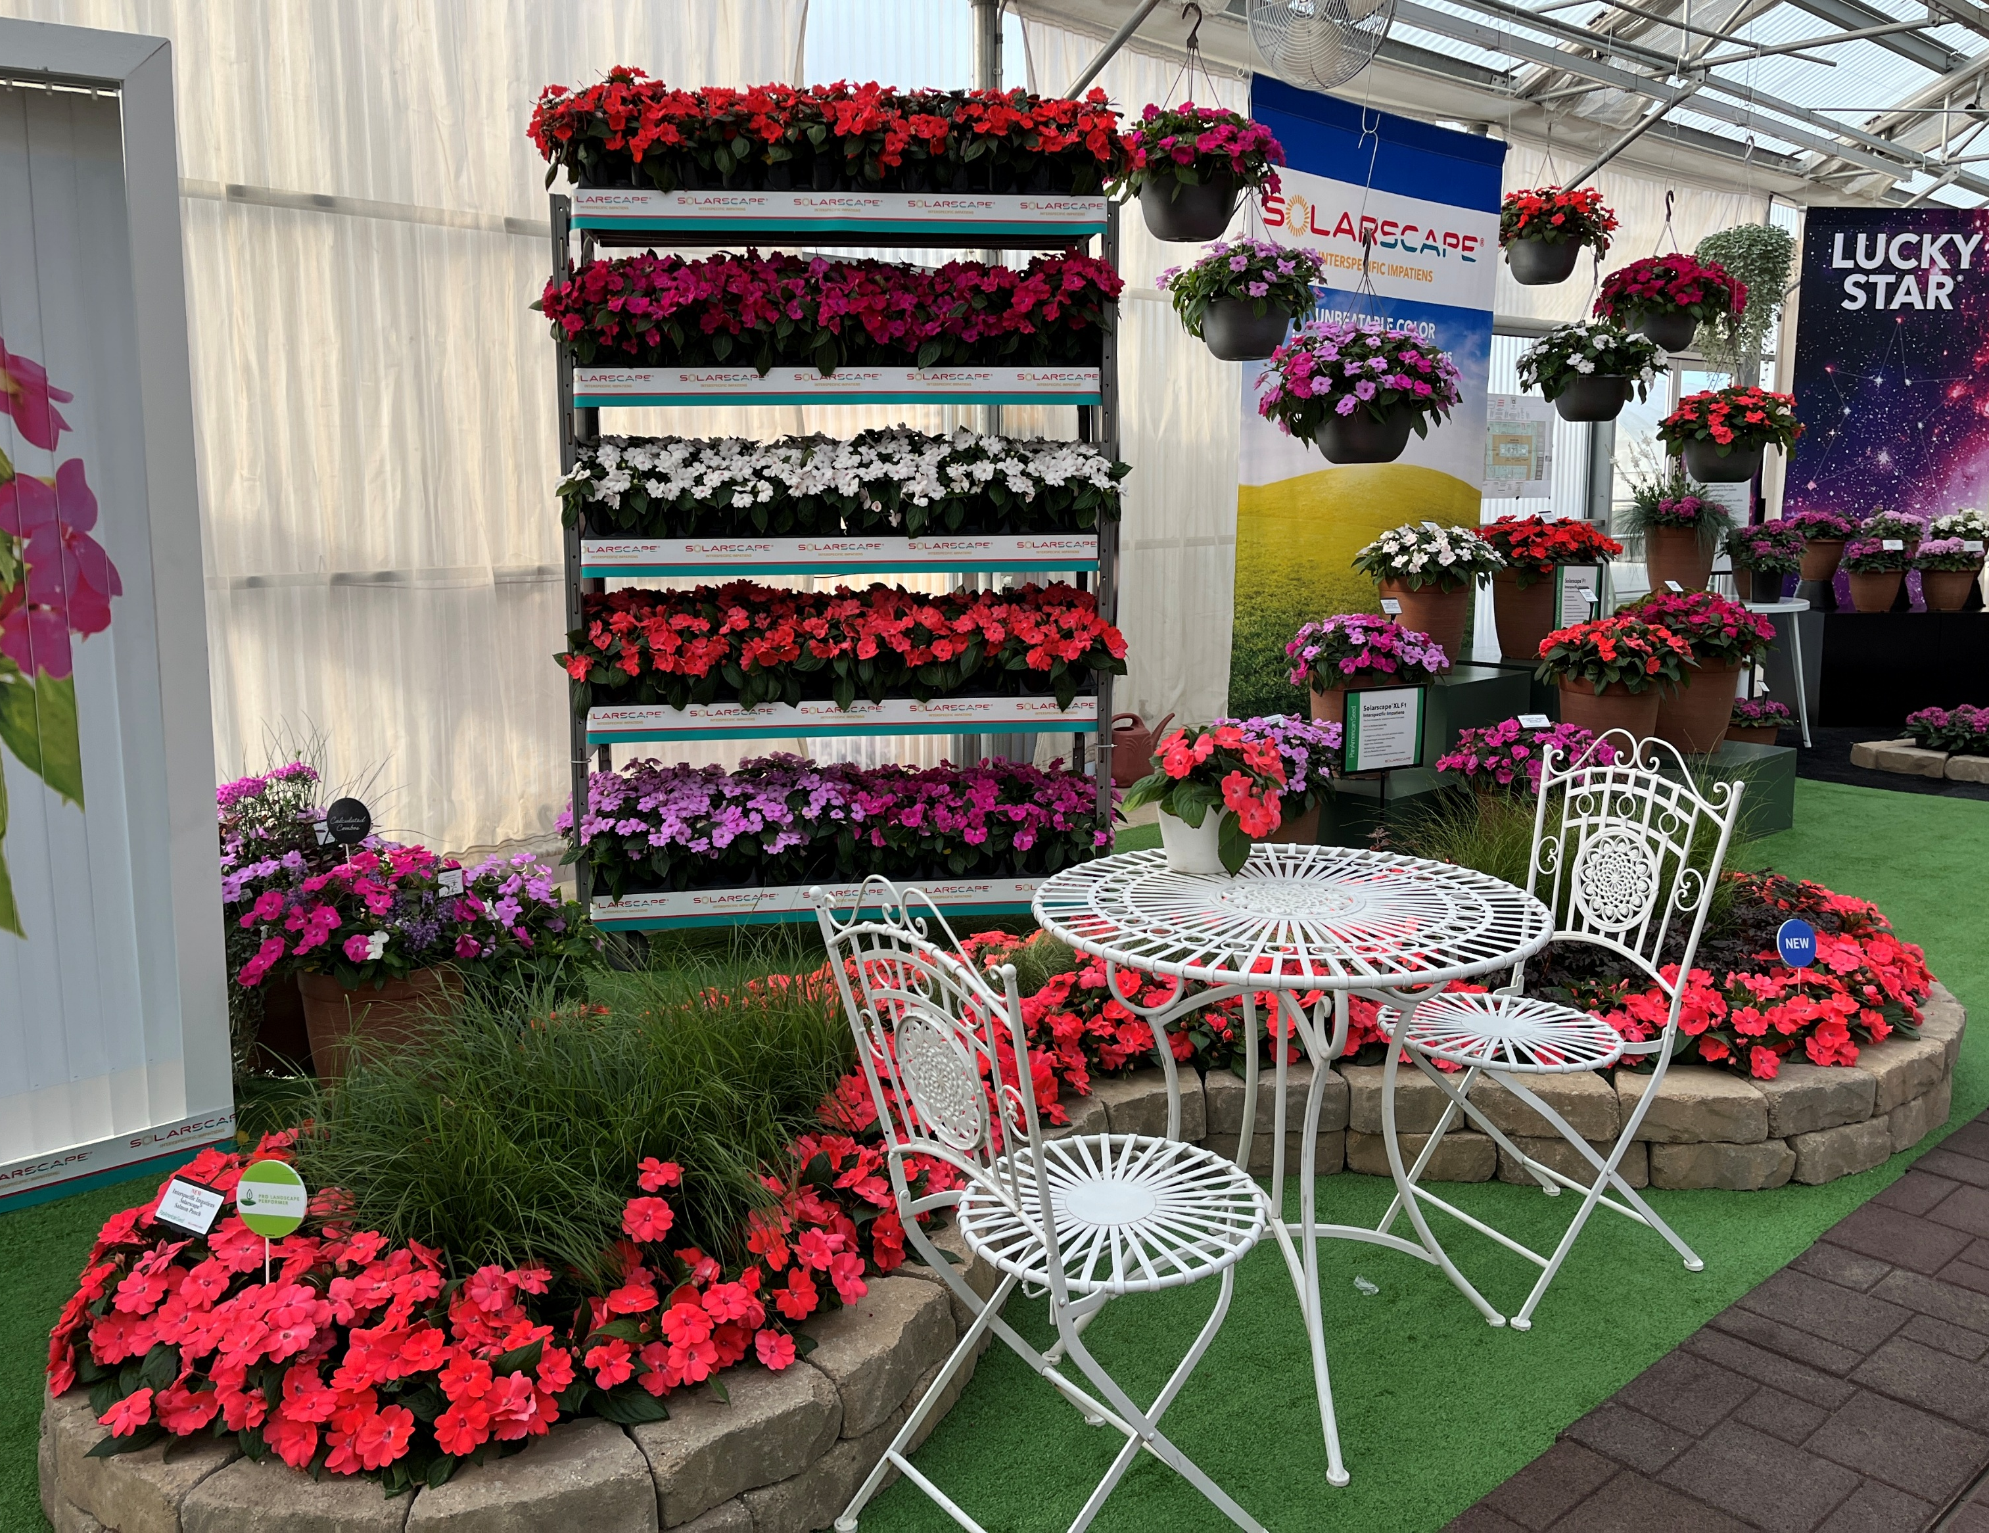

Interspecific Impatiens Solarscape® XL Series F1
Impatiens landscapers love​
​
Solarscape seed-propagated interspecific impatiens provides unbeatable color in full-sun garden beds and containers. ​
​
XL plant height averages about 20% larger ​
than standard Solarscape.​
Great low-maintenance plant provides high-color impact in full-sun spaces, whether in the ground or in containers.​
The Interspecific Impatiens series offers growers the flexibility of a seed input that is available all year round, making scheduling a breeze.​
Offers landscape growers a non-branded, cost-efficient alternative. – no royalty or tag needed
New Solarscape Salmon Punch replaces Salmon Glow,
Height: 11 to 13 in./28 to 33 cm​
Spread: 18 to 20 in./46 to 51 cm
​
Plug crop time: ​
(288) 4 to 5 weeks, ​
(128) 5 to 6 weeks​
Transplant to finish: 7 to 10 weeks
​
Seed supplied as:​
Raw with 85% Min. Germ. Standard

Slide 10
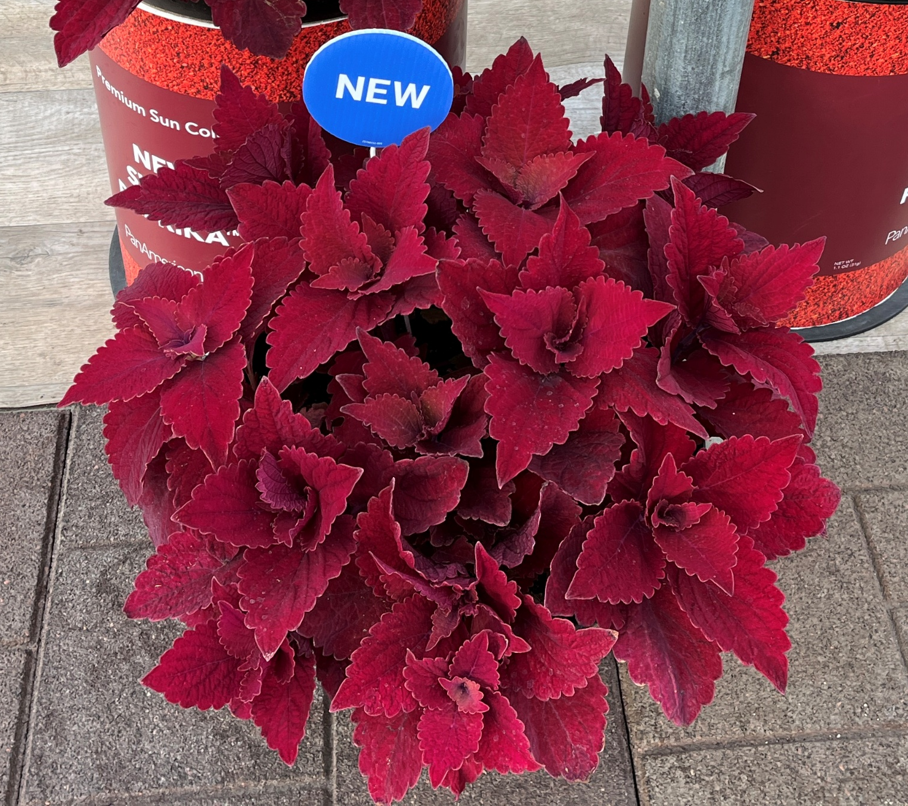
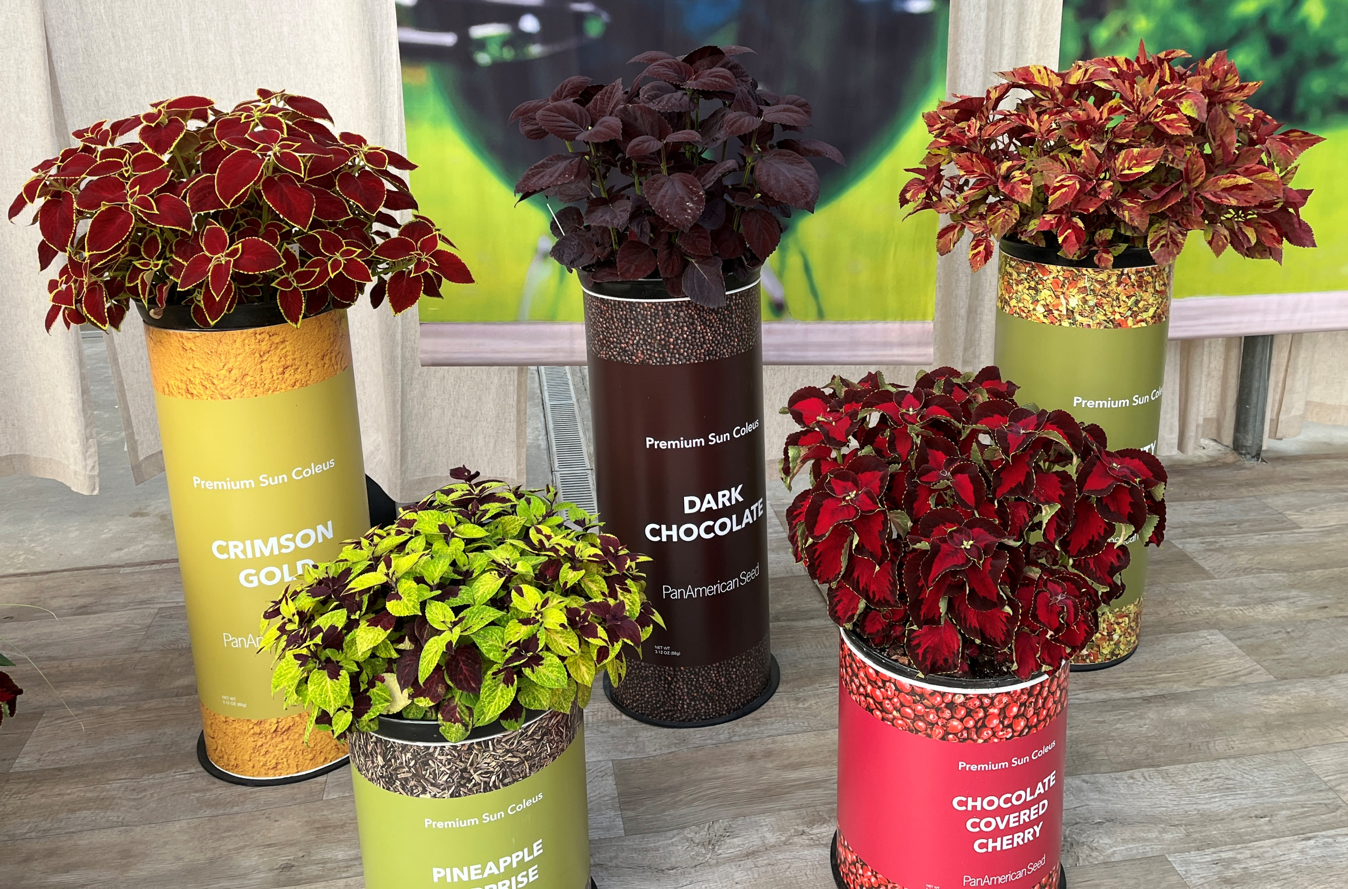
Coleus Premium Sun Sweet Paprika
Sun Premium offers Showstopping colors…bold patterns…rich textures​
Landscapers and gardeners love center-stage varieties for their great looks and reliable performance in sunny gardens and patio planters.
Well Branched plants with medium vigor
Versatile and thrives in sun and shade
Very late to flower
Height: 15 to 24 in./38 to 61 cm​
Spread: 12 to 18 in./30 to 46 cm​
Plug crop time: 5 to 6 weeks​
Transplant to finish: ​
6 to 8 weeks​
Seed supplied as: ​
Raw with 90% Min. Germ. Standard

Slide 11
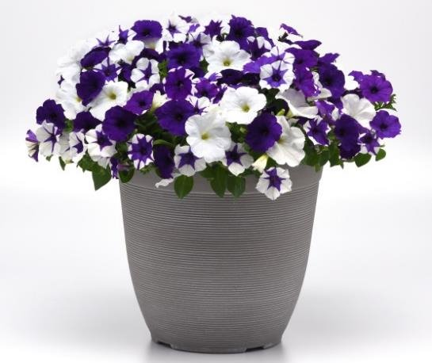

Spreading Petunia E3 Easy Wave® Series F1
Wake up early season sales! ​
It’s Early, it’s Efficient, it’s the Evolution ​
of Easy Wave®…it’s E3!​
This Wave® series flowers at 10 hours daylength, and ​
it will be ready at retail to kick off petunia sales even earlier! ​
New Deja vu Mixture includes blue, white and future intro Midnight Marble.
Offers simplified production, as it can be successfully grown at lower PGR rates than Easy Wave (except Blue).
All E3 Easy Wave varieties have a similar, uniform plant structure and vigor, which means simplified plant management.​
Mounding, spreading habit offers a three-dimensional landscape effect, creating impressive baskets and planters
Recommended in Wave branded packaging: 6-in./15-cm pots, premium quarts and gallons, 306 premium packs with handle and hanging baskets.
Height: 6 to 12 in./15 to 30 cm​
Spread: 25 to 32 in./64 to 81 cm
​
Plug crop time: 4 to 6 weeks​
Transplant to finish: ​
Spring 6 to 7 weeks​
Summer 4 to 5 weeks​
Seed supplied as:
​Pelleted with 85% Min. ​
Germ. Standard

Slide 12


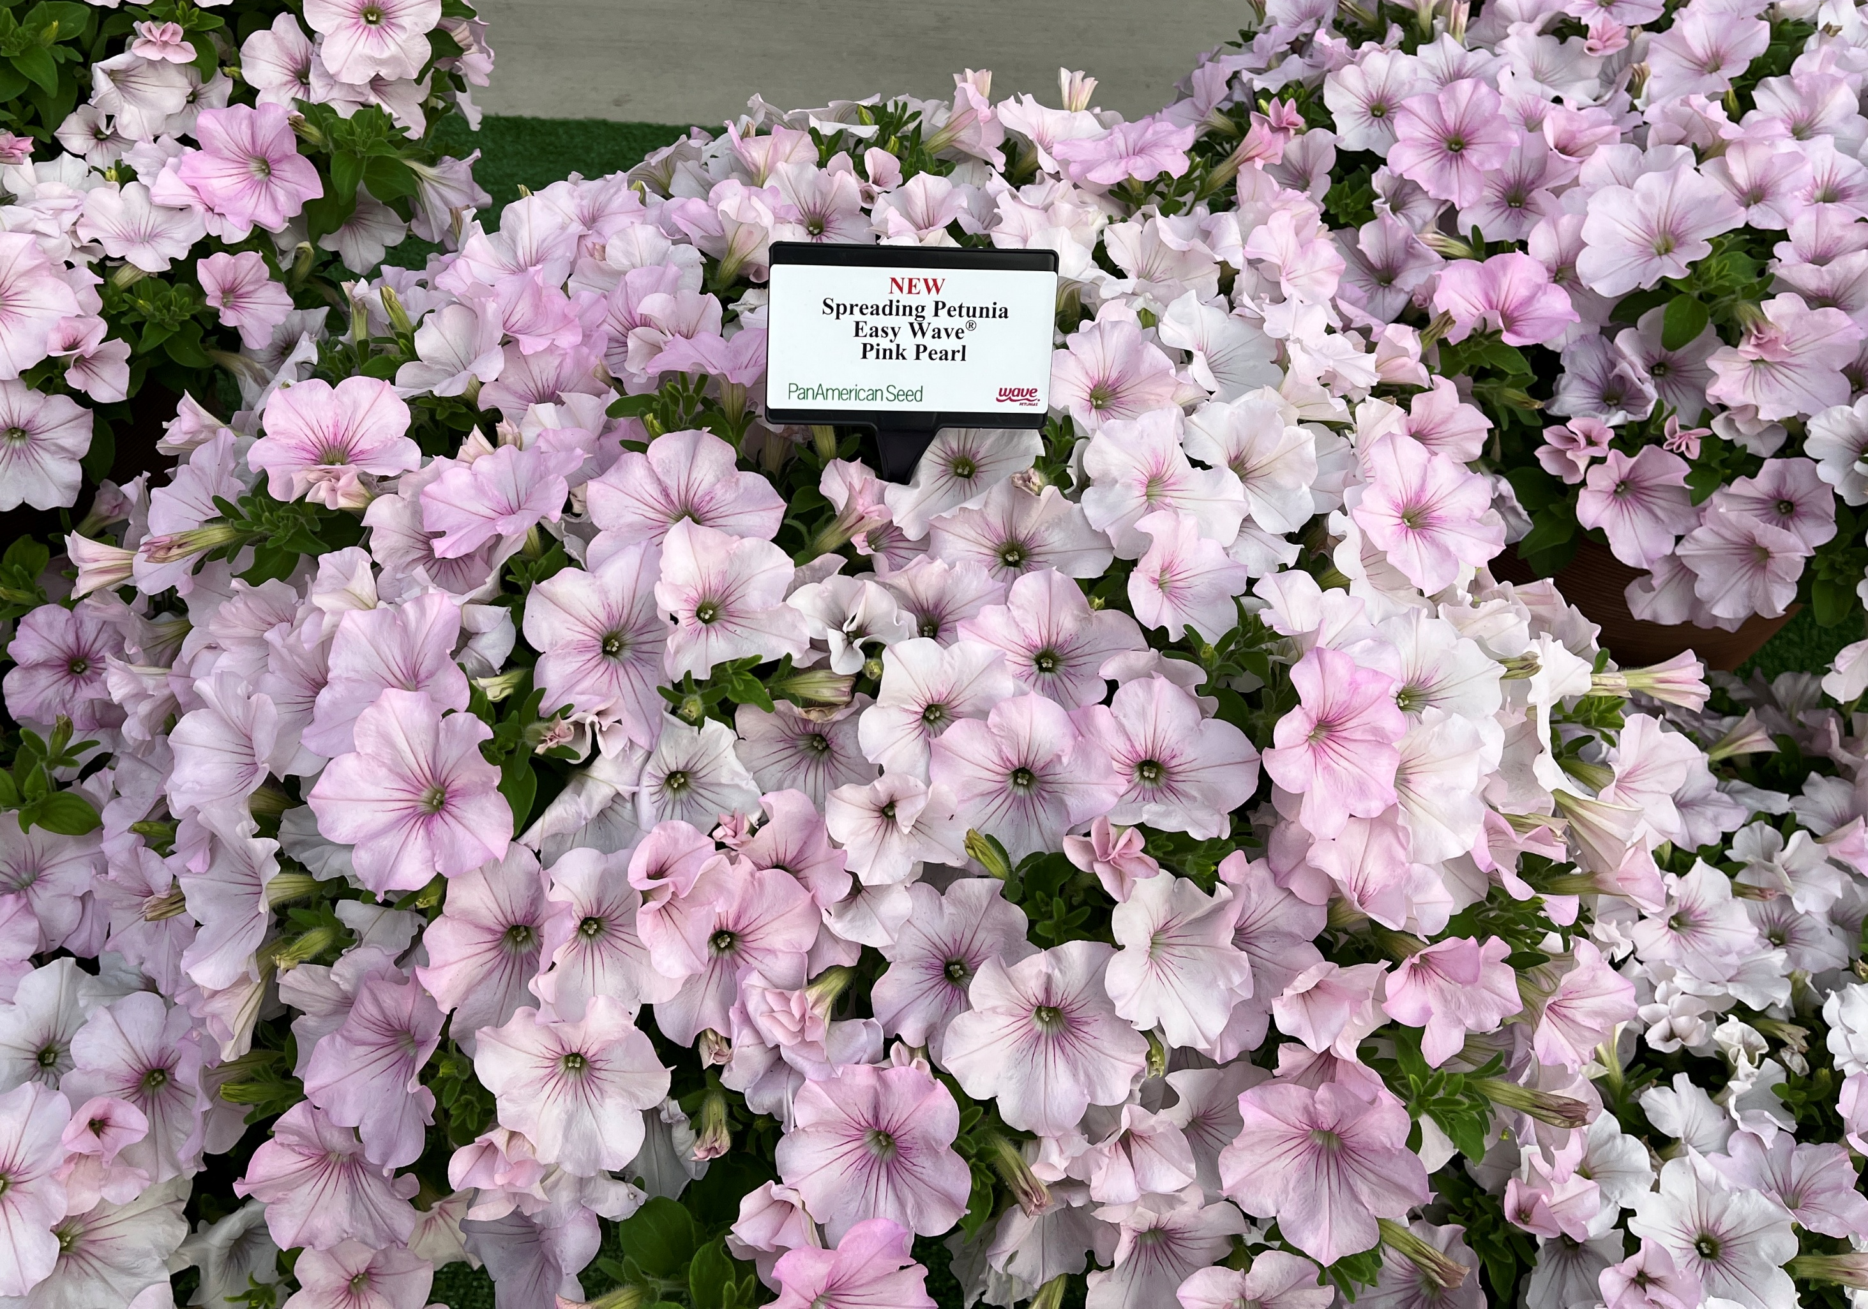
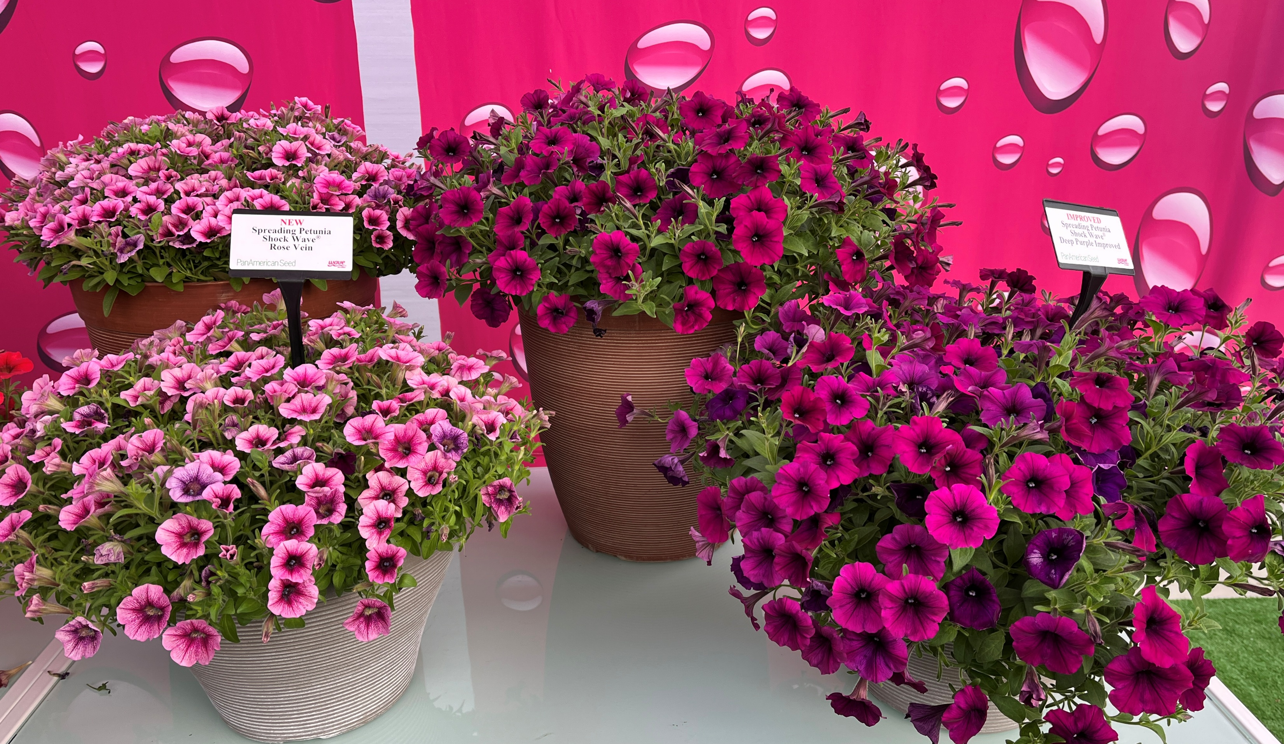
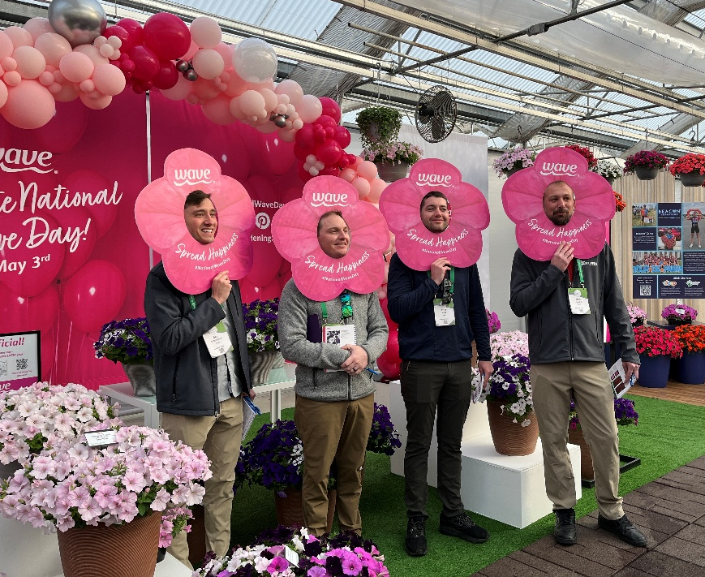
Other New Petunia Waves
Easy Wave® Pink Pearl – darker under cooler lower light conditions, lighter when warmer and higher light
Shock Wave® Rose Vein, Violet, Deep Purple Improved, Red improved
Improvements = better tolerance for cold growing
See chart with daylengths, can mix some EW and SW if have similar requirements

Slide 13

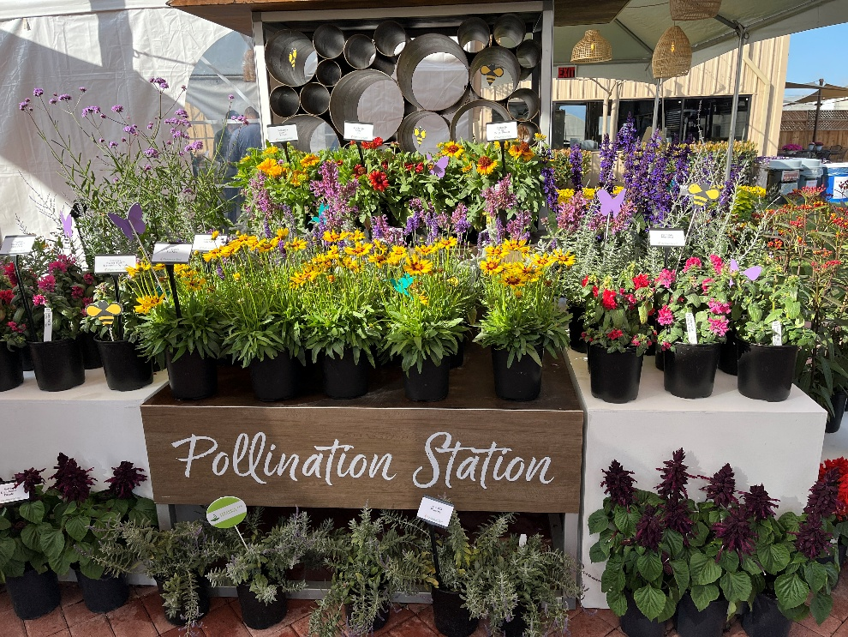
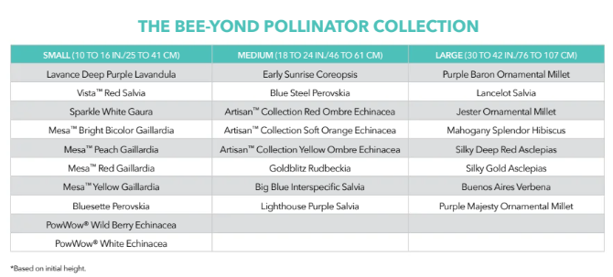
Bee-Yond Pollinator Program
Curated collection of plants that attract pollinators of all kinds
Cost savings from seed production and decreased labor
Environmental Advantages – ecosystems depend on pollinators

Slide 14
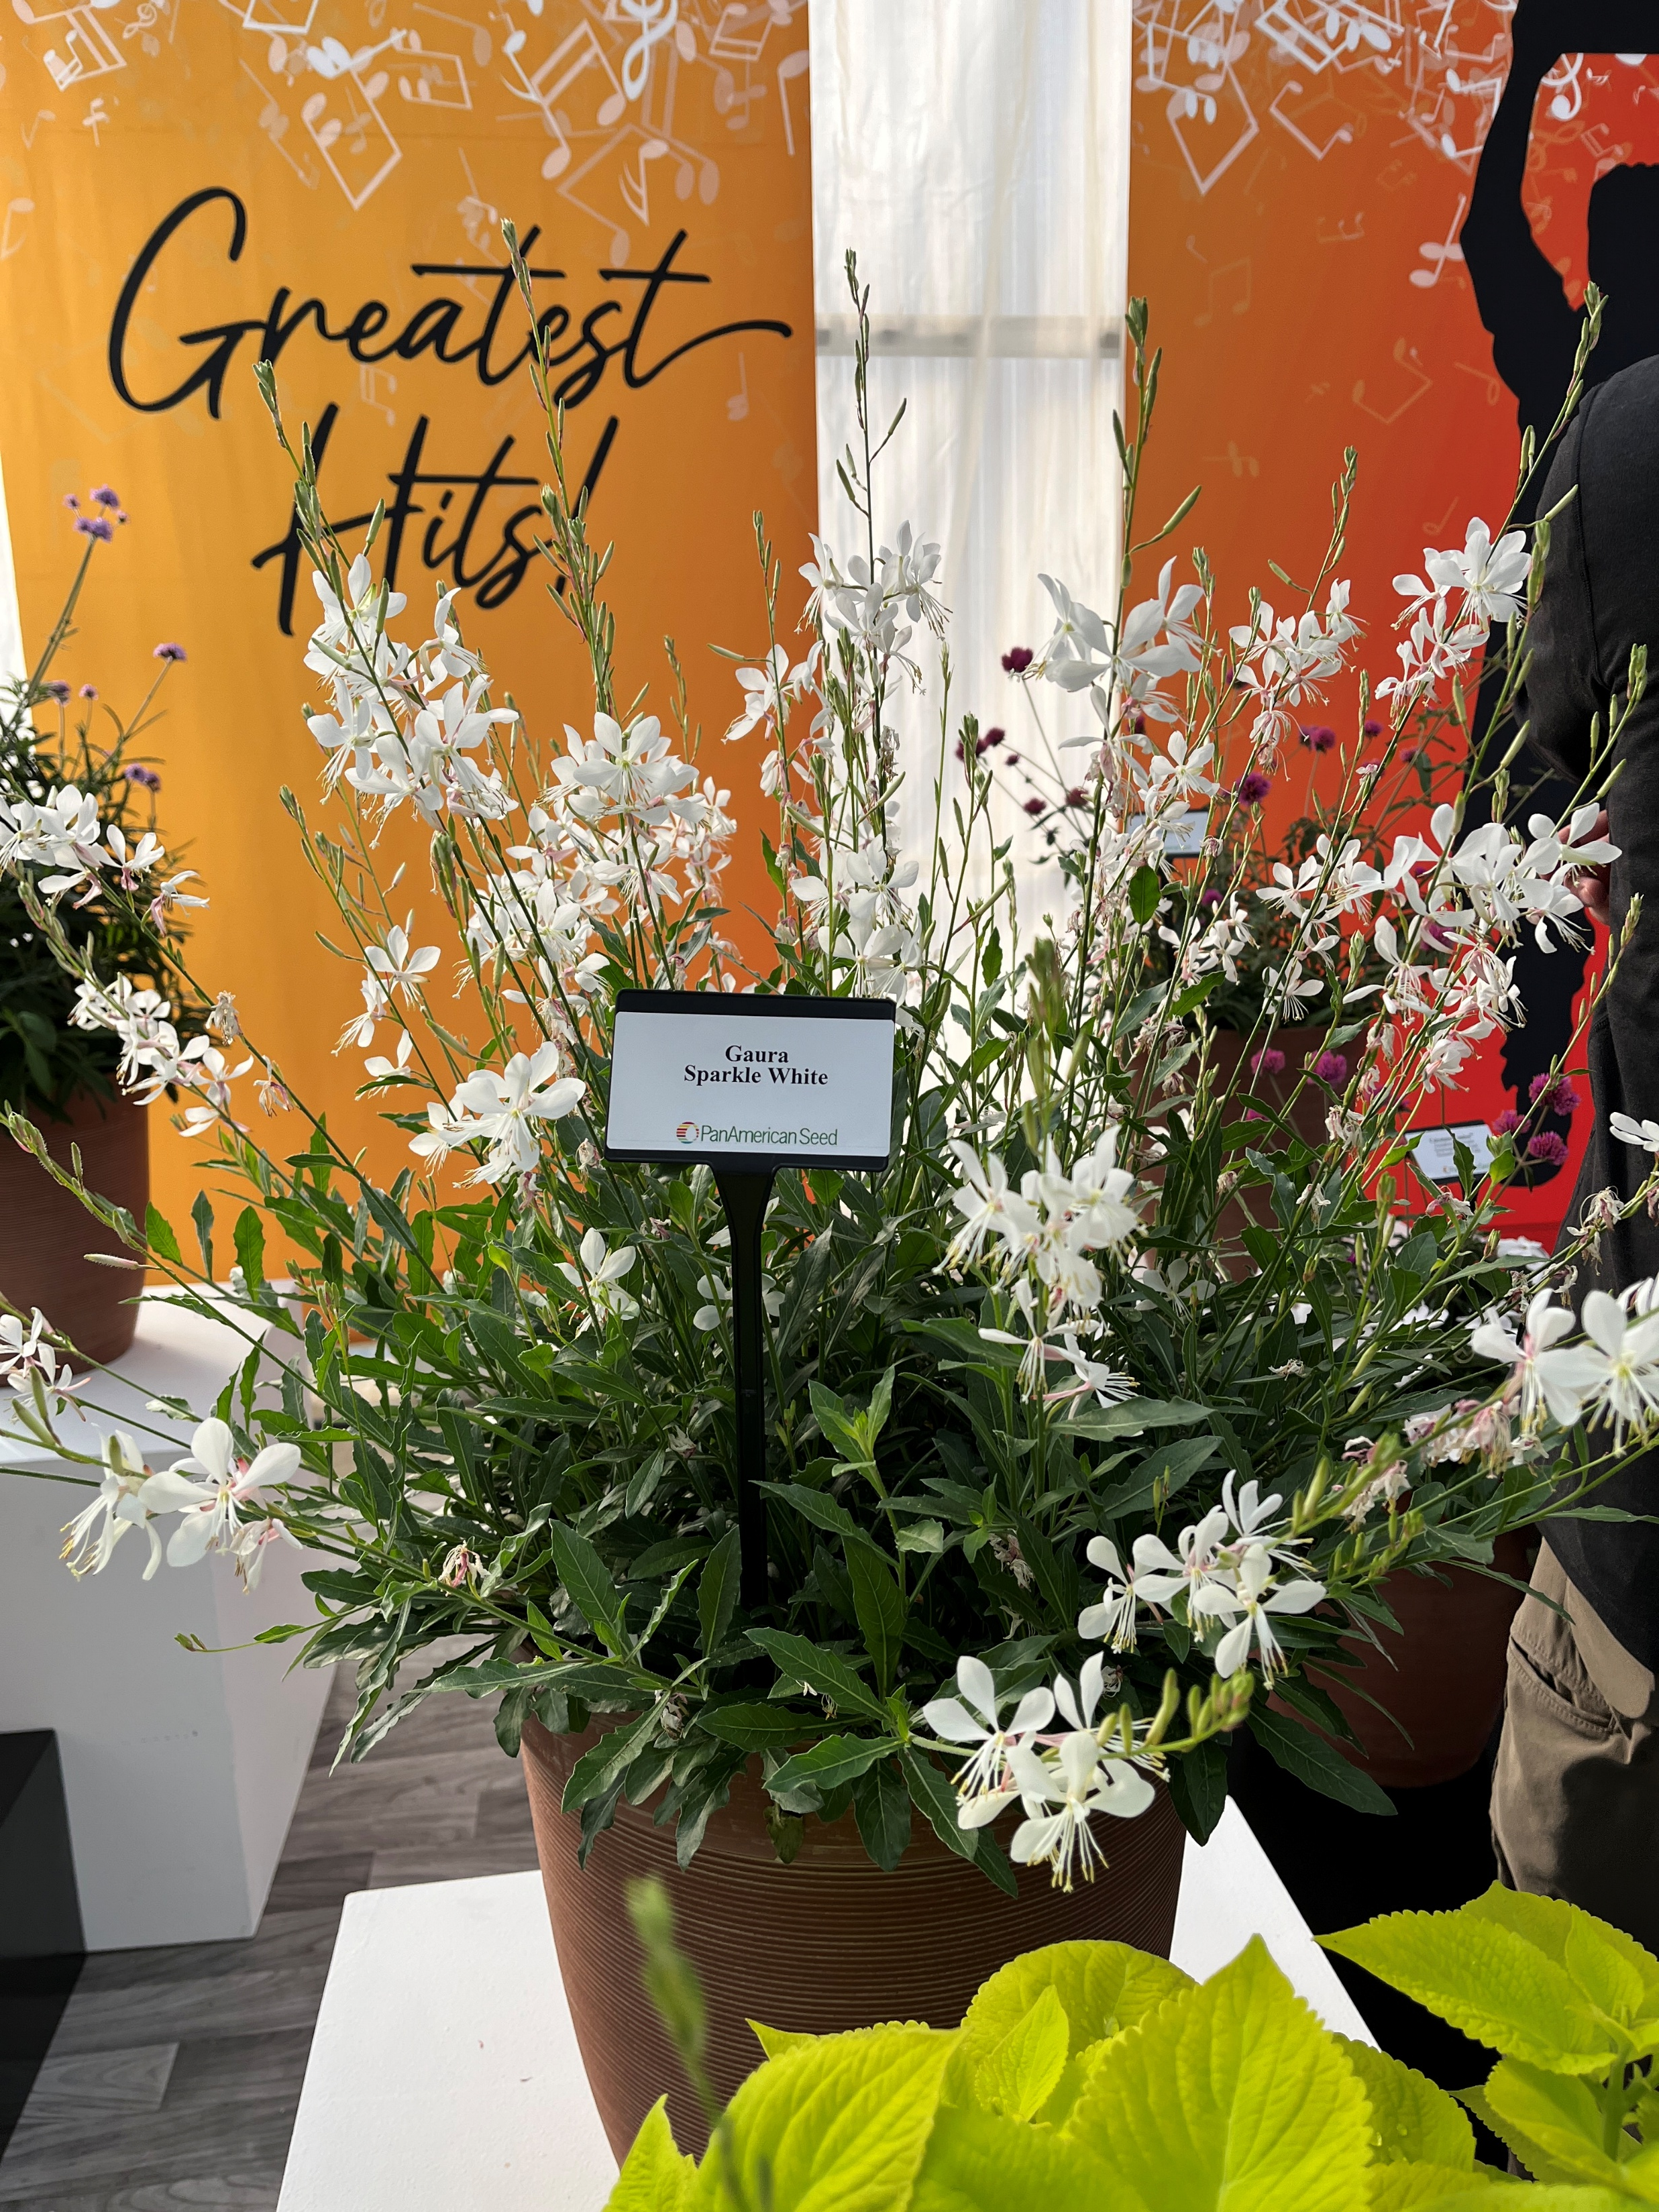
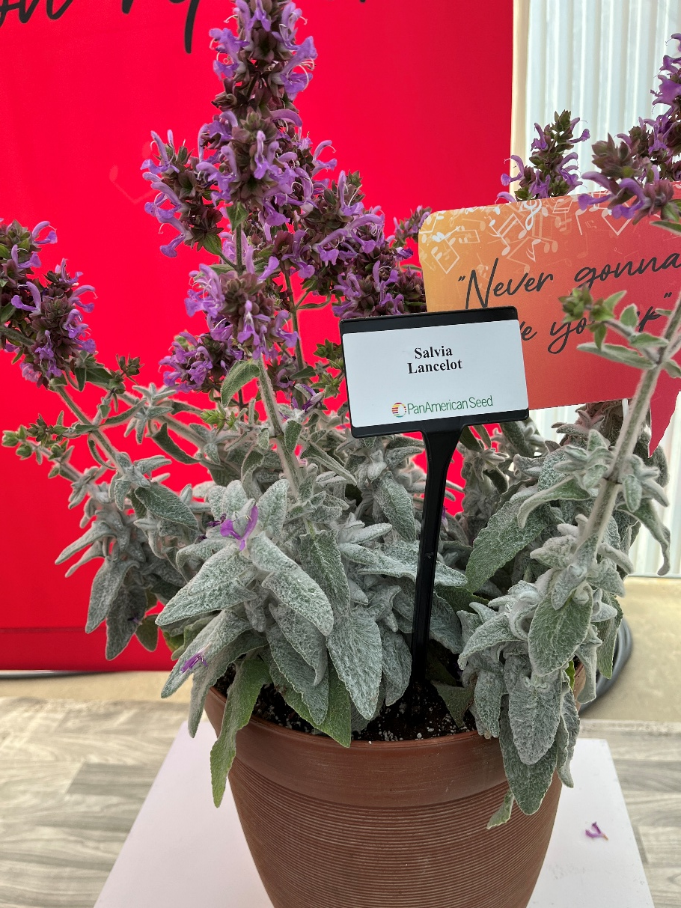
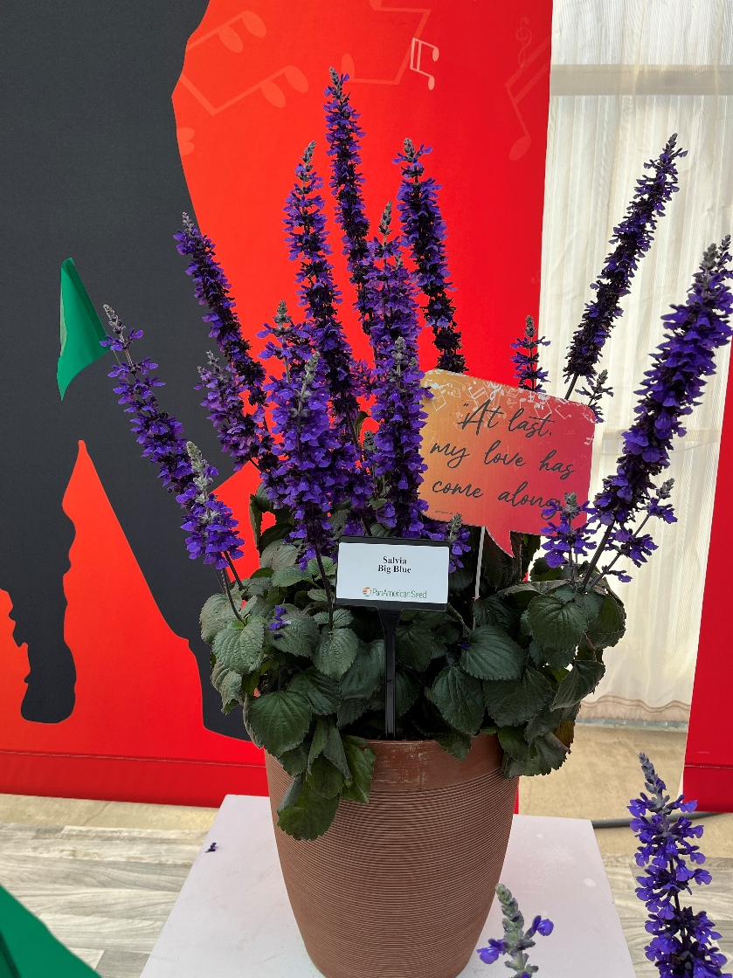
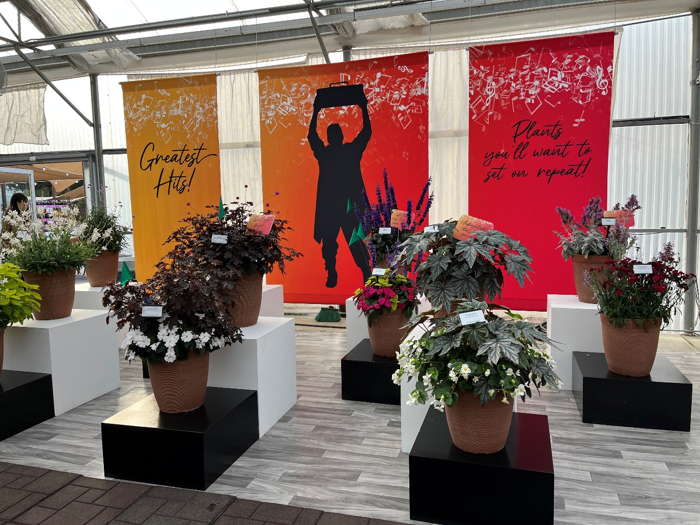
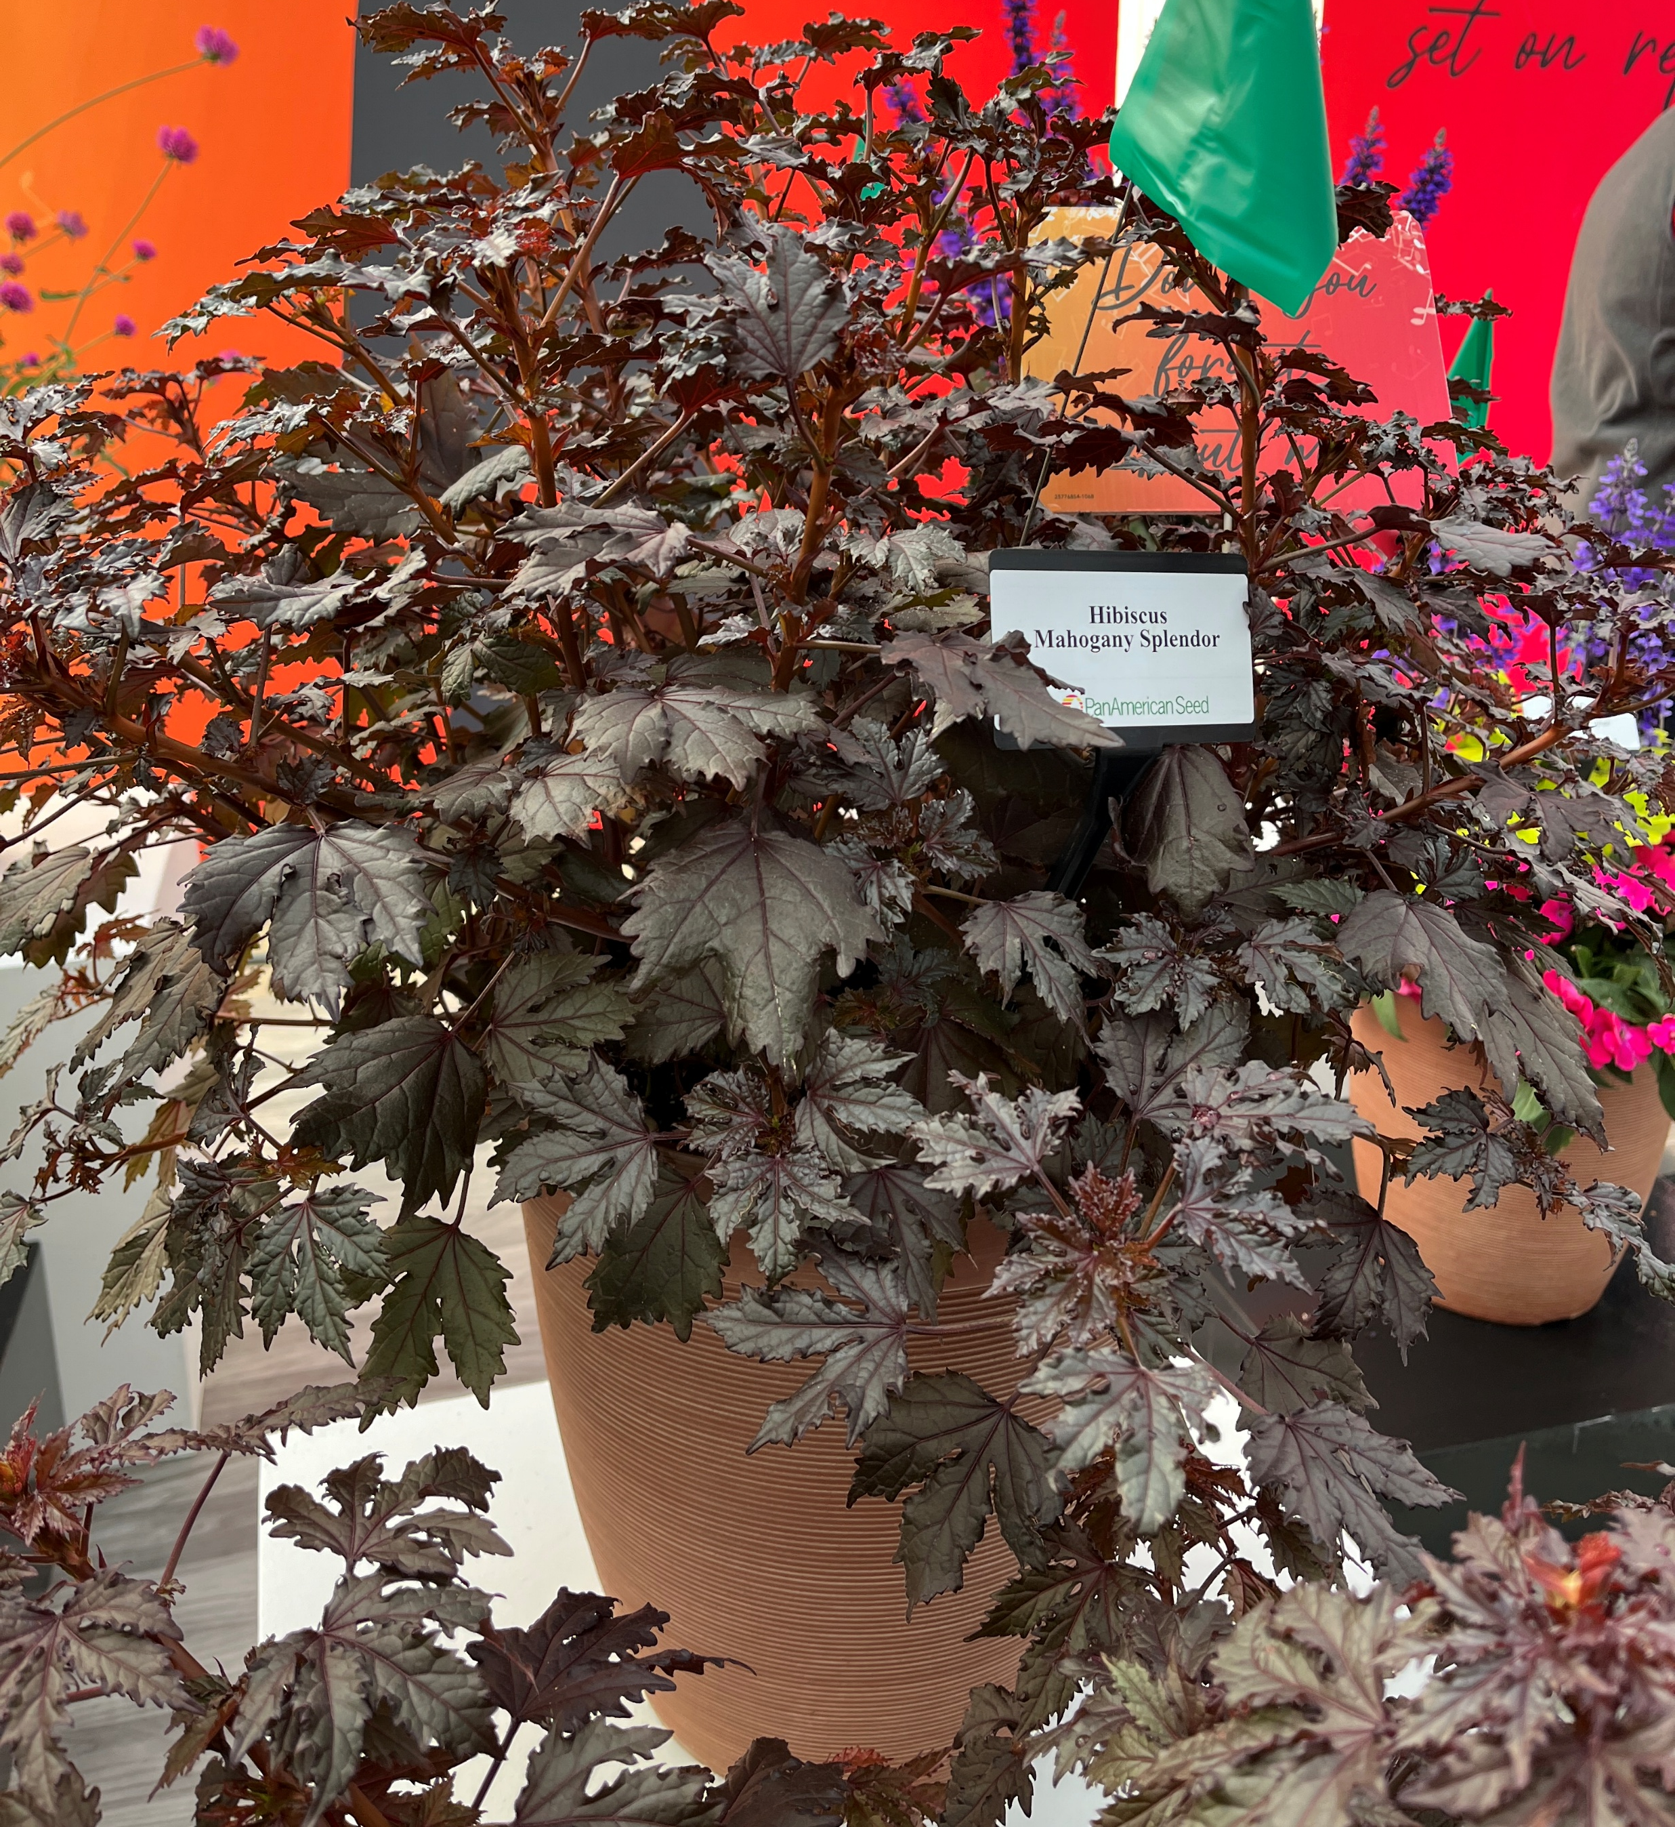
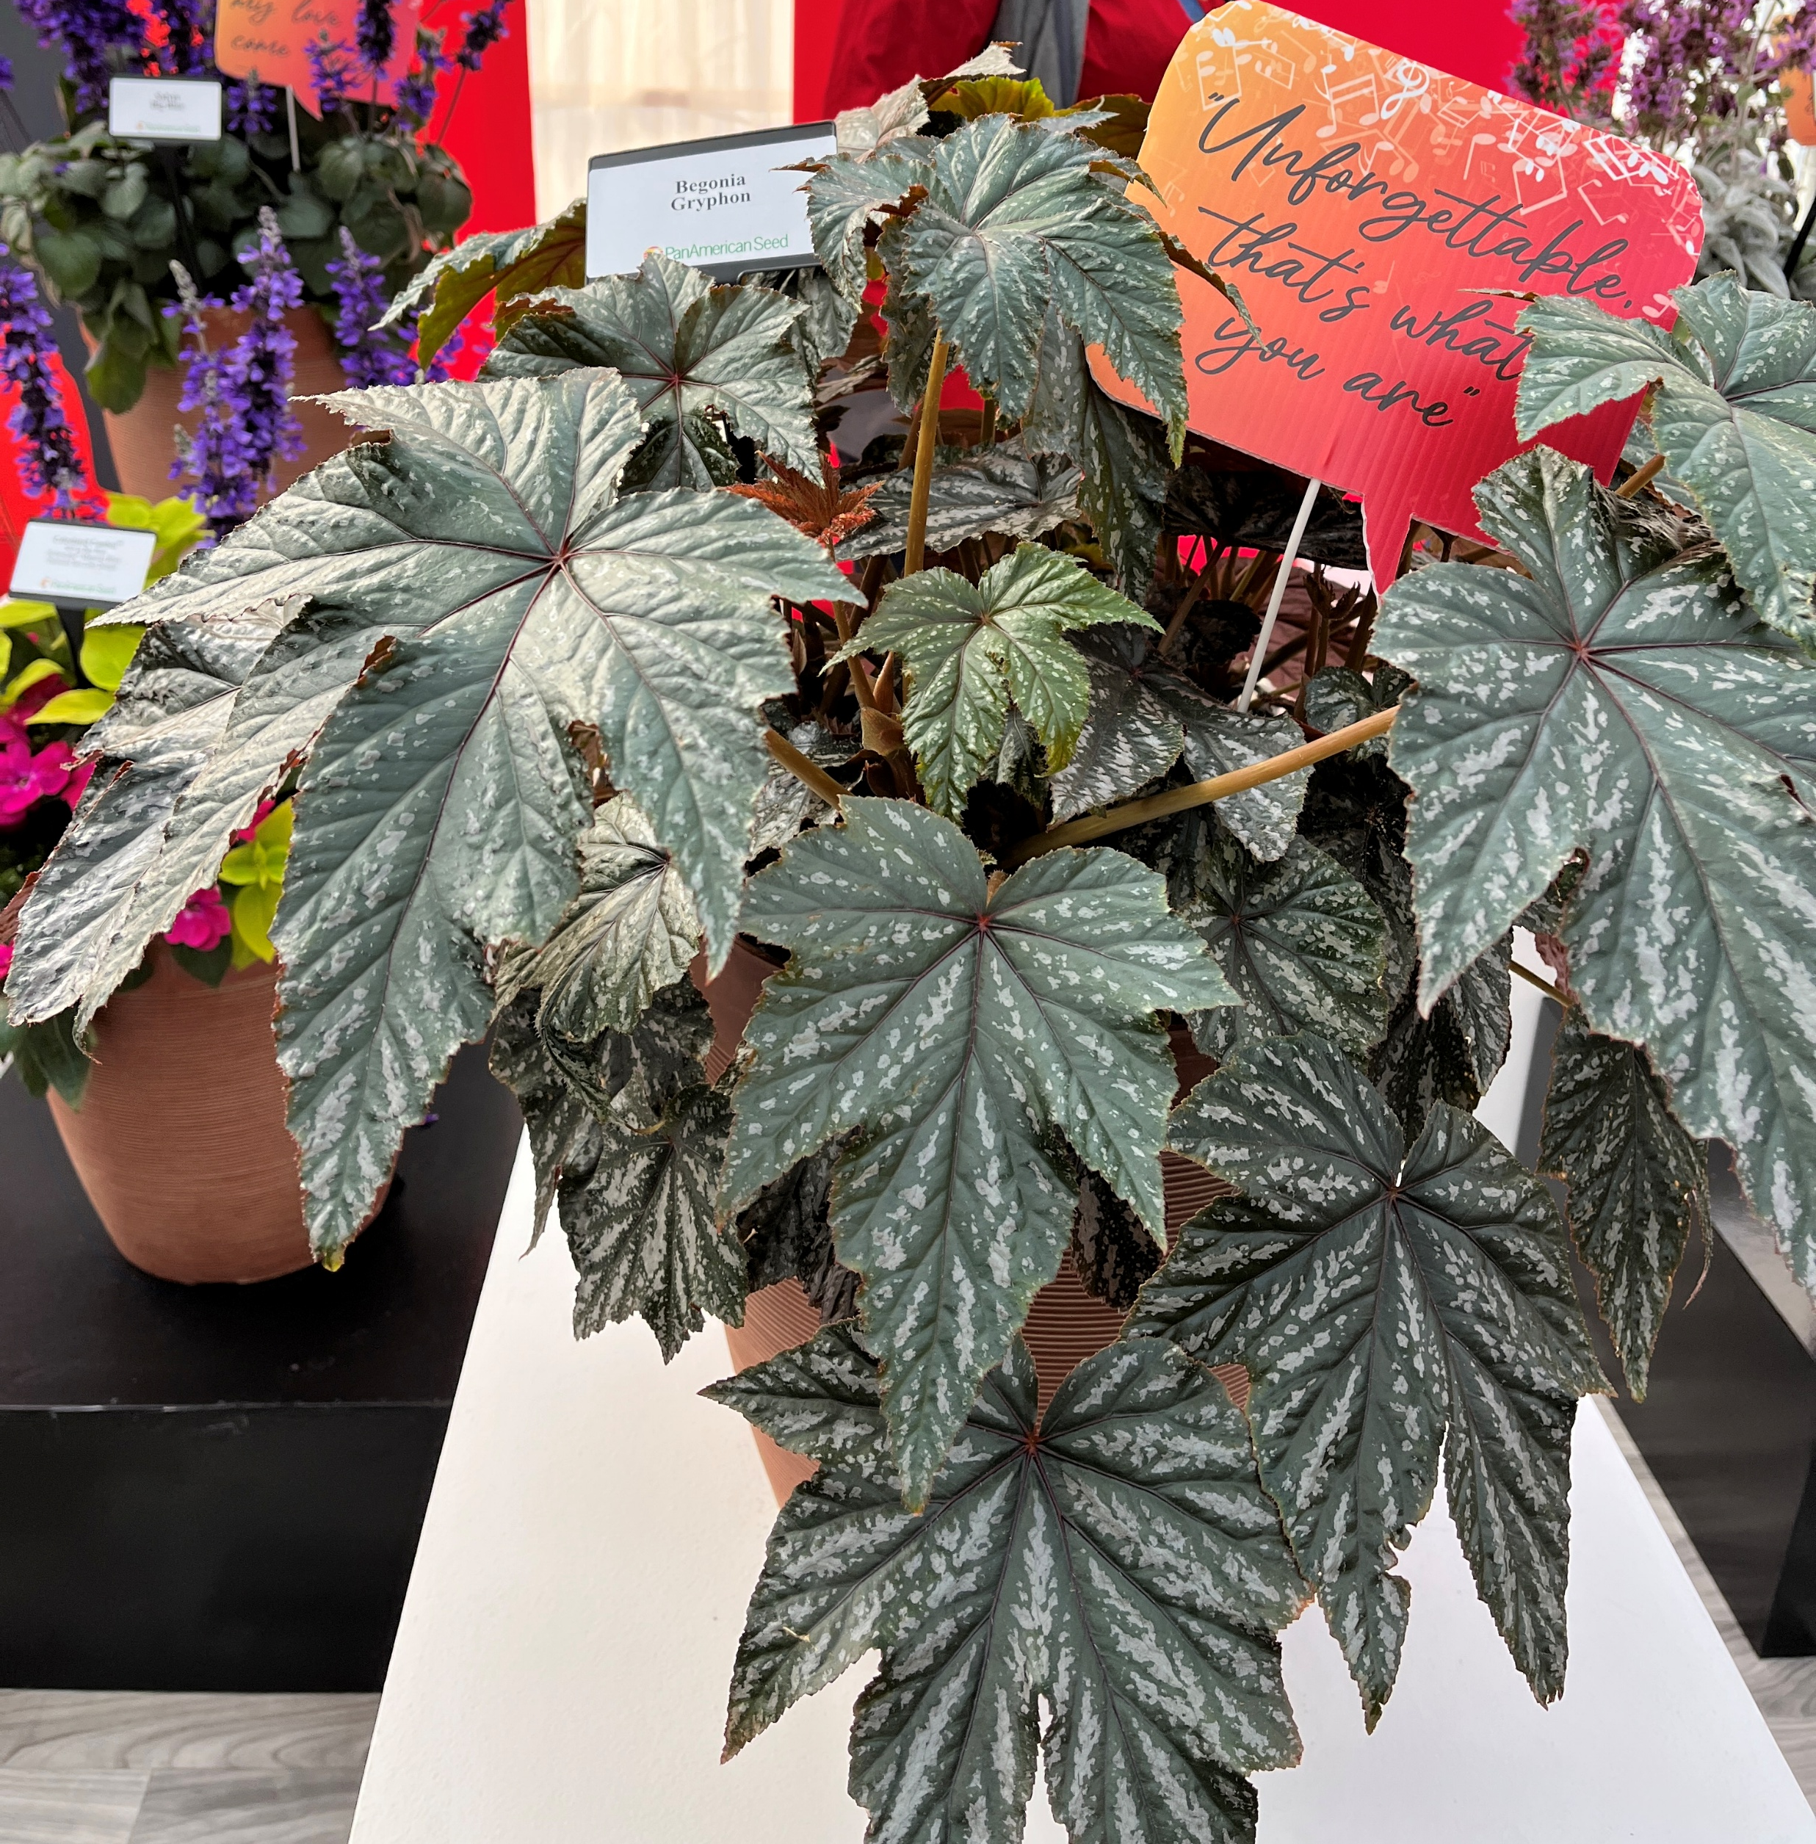
Premium Seed underutilized items offer higher profit
Includes - Gaura Sparkle White, Salvia Lancelot, Salvia Big Blue, Hibiscus Mahogany Splendor, Begonia Gryphon
Use alone or in mixed containers for summer and later season sales

Slide 15

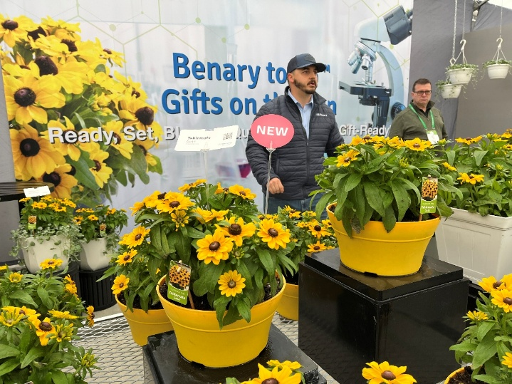
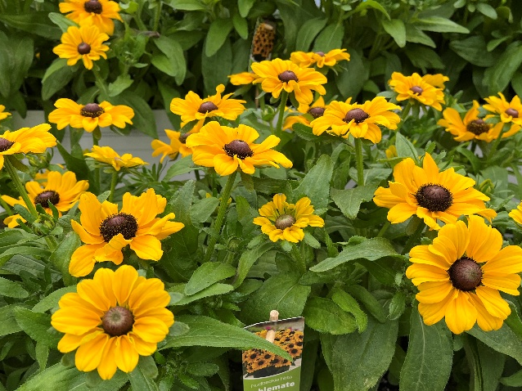
Rudbeckia hirta Tablemate Gold
New genetically compact pot type Rudbeckia is 8 – 10” tall
15 - 17 weeks seeds to finish for spring sales, 14-15 weeks for summer
LD obligate, no pinch, no PGR
Pot gift crop

Slide 16
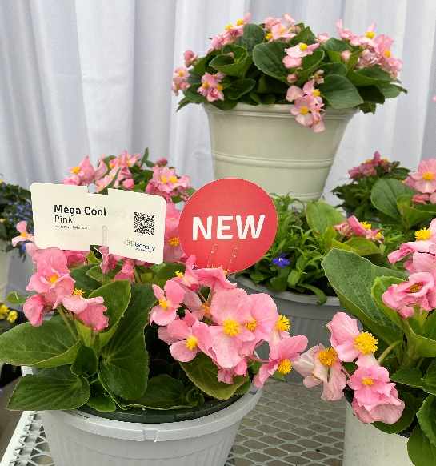
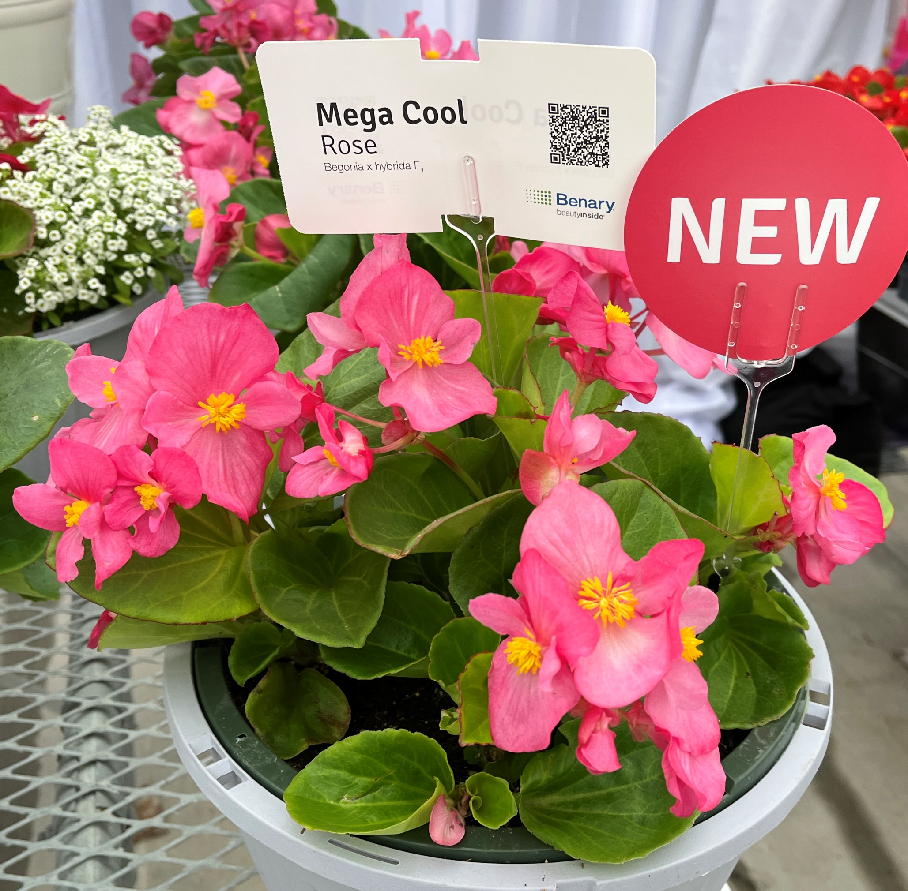
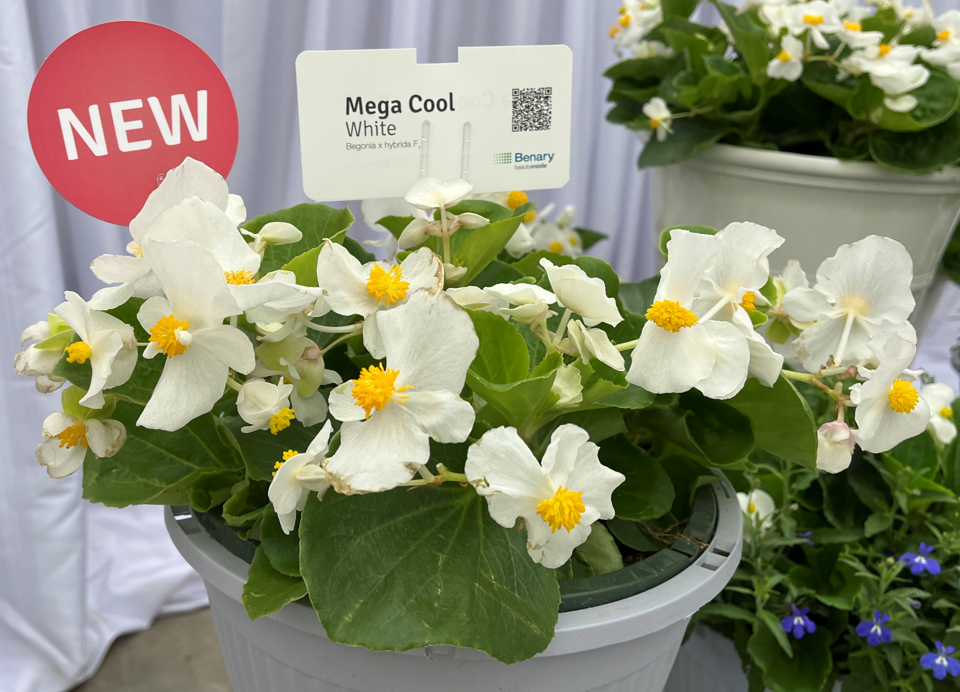
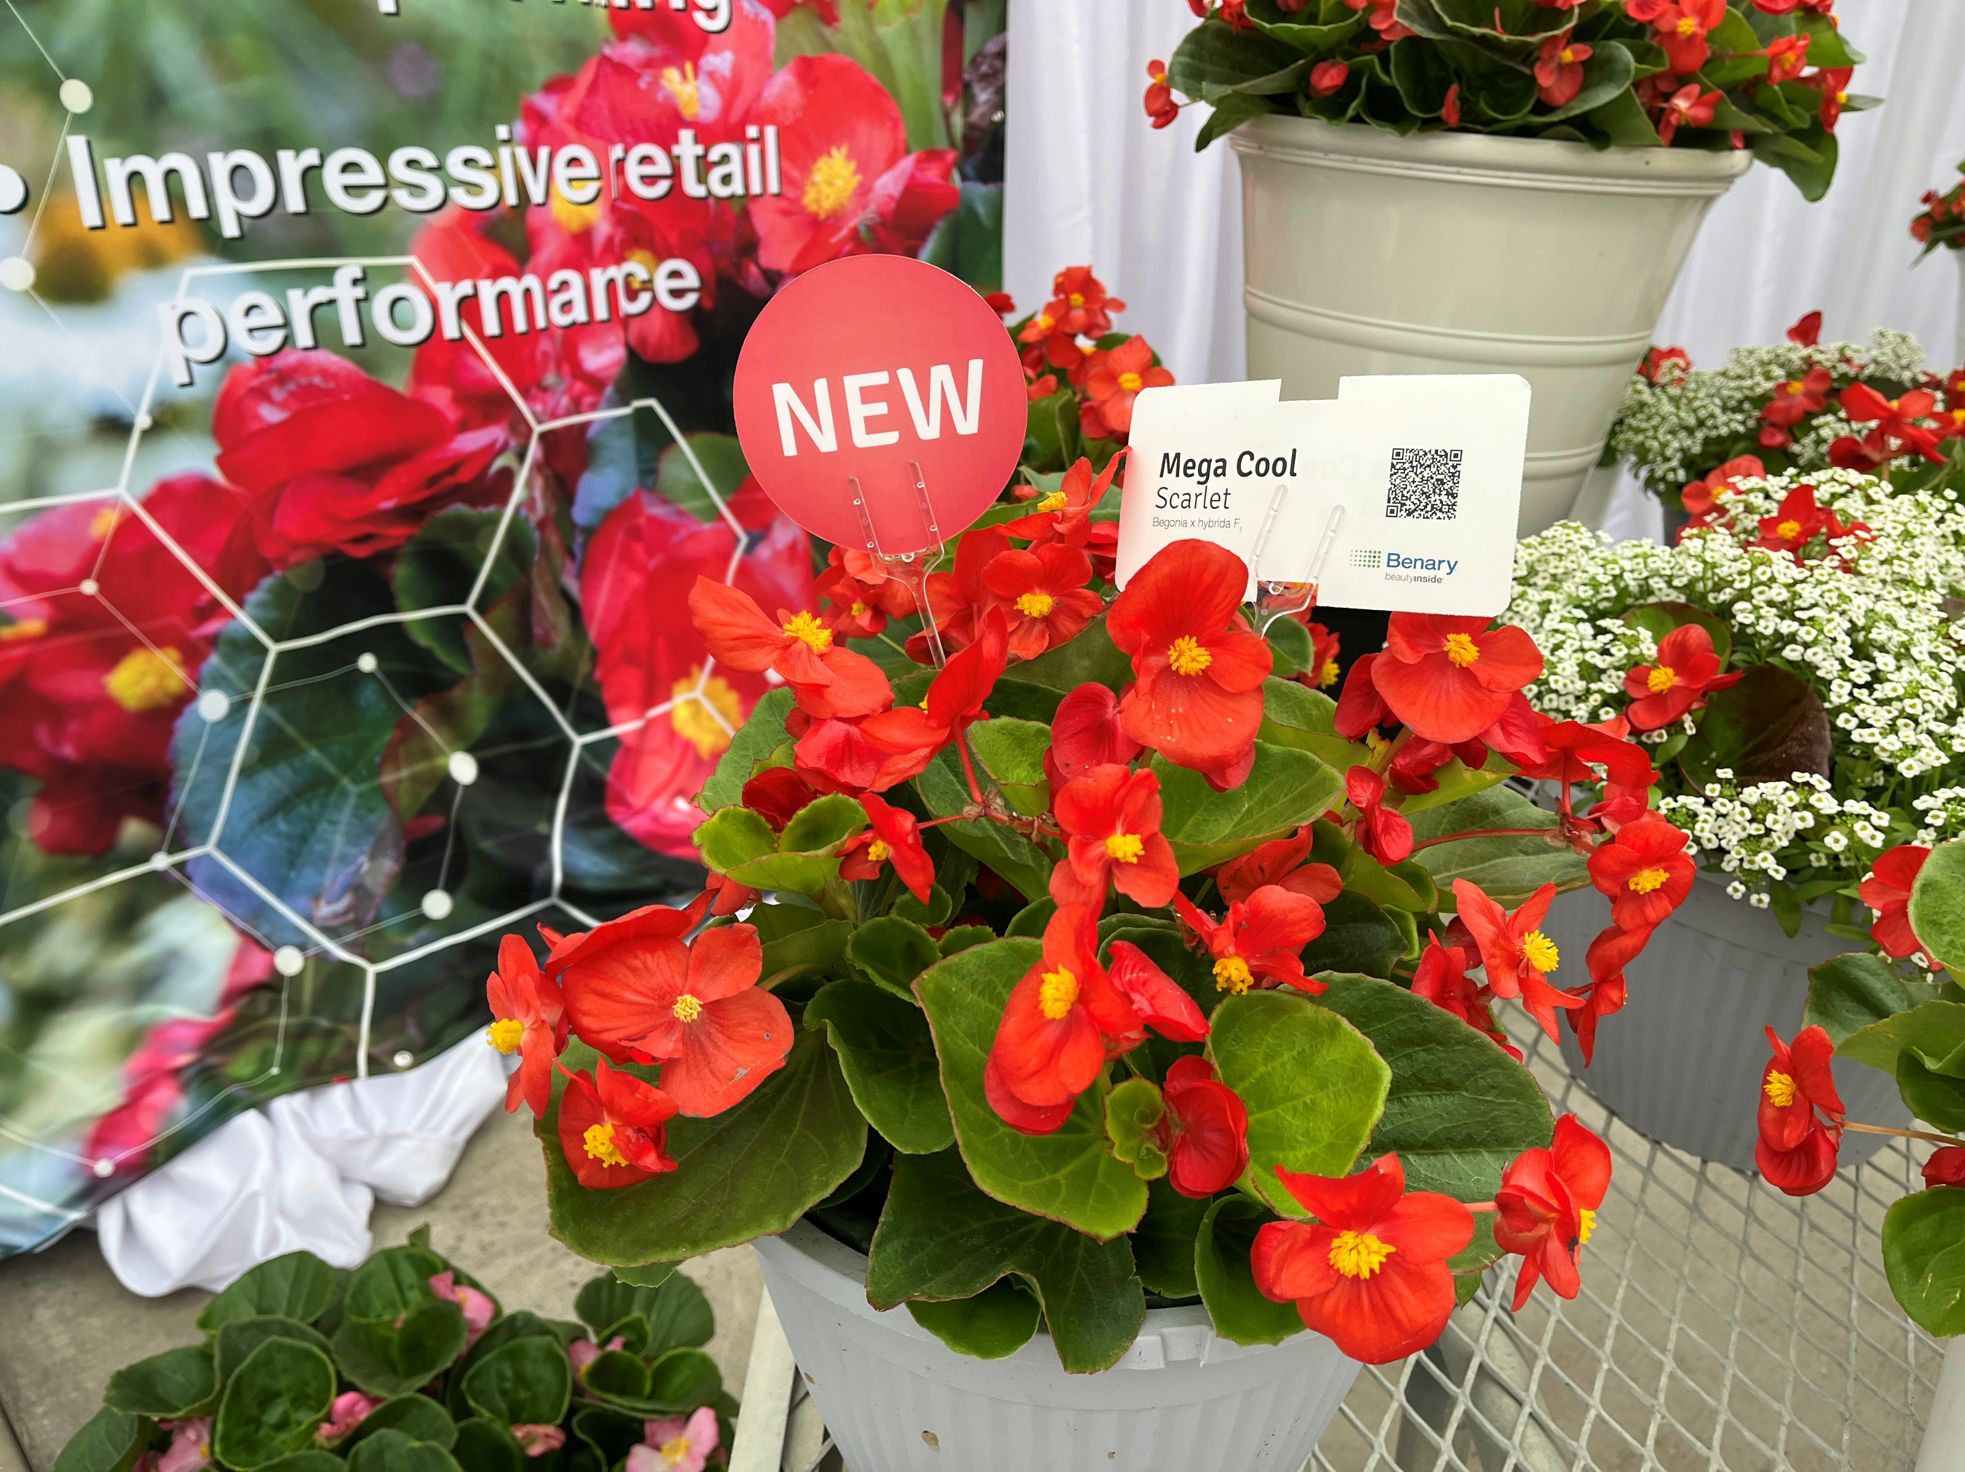
Begonia Mega Cool - New Series
Begonia semperflorens F1 hybrid
Compare to TopHat, this is 10 days earlier and more uniform in timing
Large flowers are similar in size to Big, but plants are about 1/3 the size
Use as an early season container or hanging basket vs Big which is used in the landscape
4 green-leafed colors - Pink, Rose, White, Scarlet

Slide 17

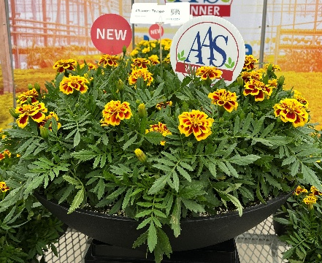
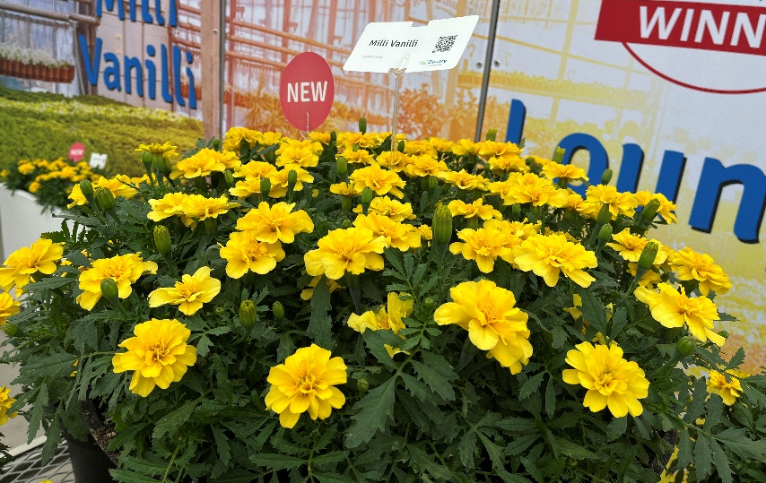
Marigolds
New tetraploid standalones are strong beefy plants
Mango Tango
  2025 AAS winner
  Anemone shaped blooms of yellow and red bicolor
  Plant habit similar to Super Hero
  8 weeks from seed to finish
Milli Vanilli
  Fades from dark yellow to light yellow
  Uniform & early flowering
  Excellent heat tolerance
  Large, semi-double anemone flowers

Slide 18

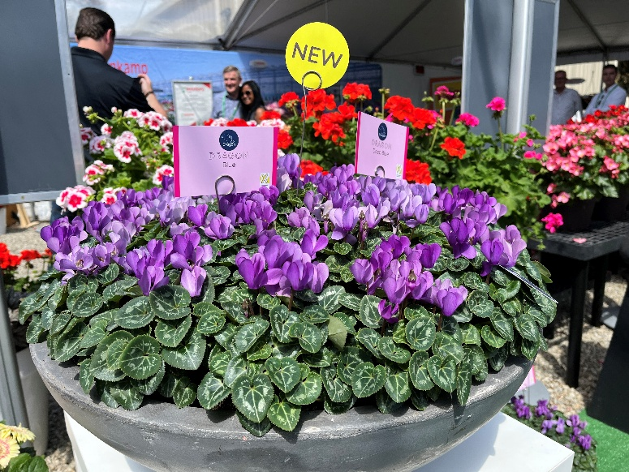
Cyclamen
Dragon Blue and Dragon Deep Blue are the 1st blue cyclamen available
F1 hybrid
Willing to work with grower via WhatsApp and virtual meetings to help growers succeed
Mini series for up to 4” pots
Available as a special order
Raw Seed

Slide 19
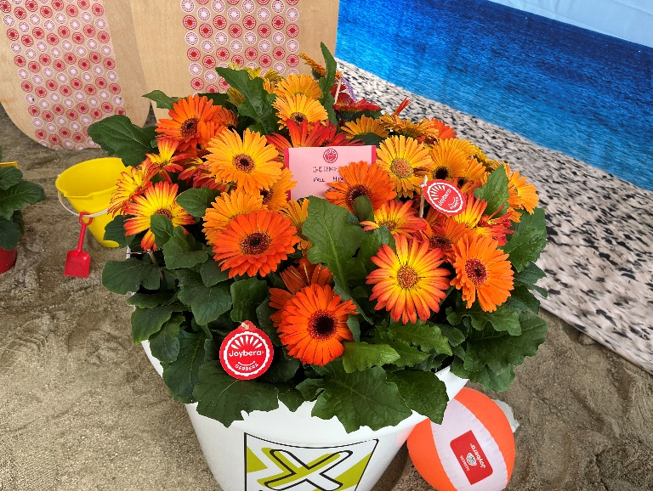
Joybera Gerbera
Florist grade gerbera with landscape performance
Coral, Dark Orange, Golden Yellow, Orange, Pink, Red, White, Yellow
Offers exceptional uniformity in timing and plant size across all colors
Each plant produces at least three blooms in its first flowering cycle, has continuous blooming and outstanding longevity

